Slide 1
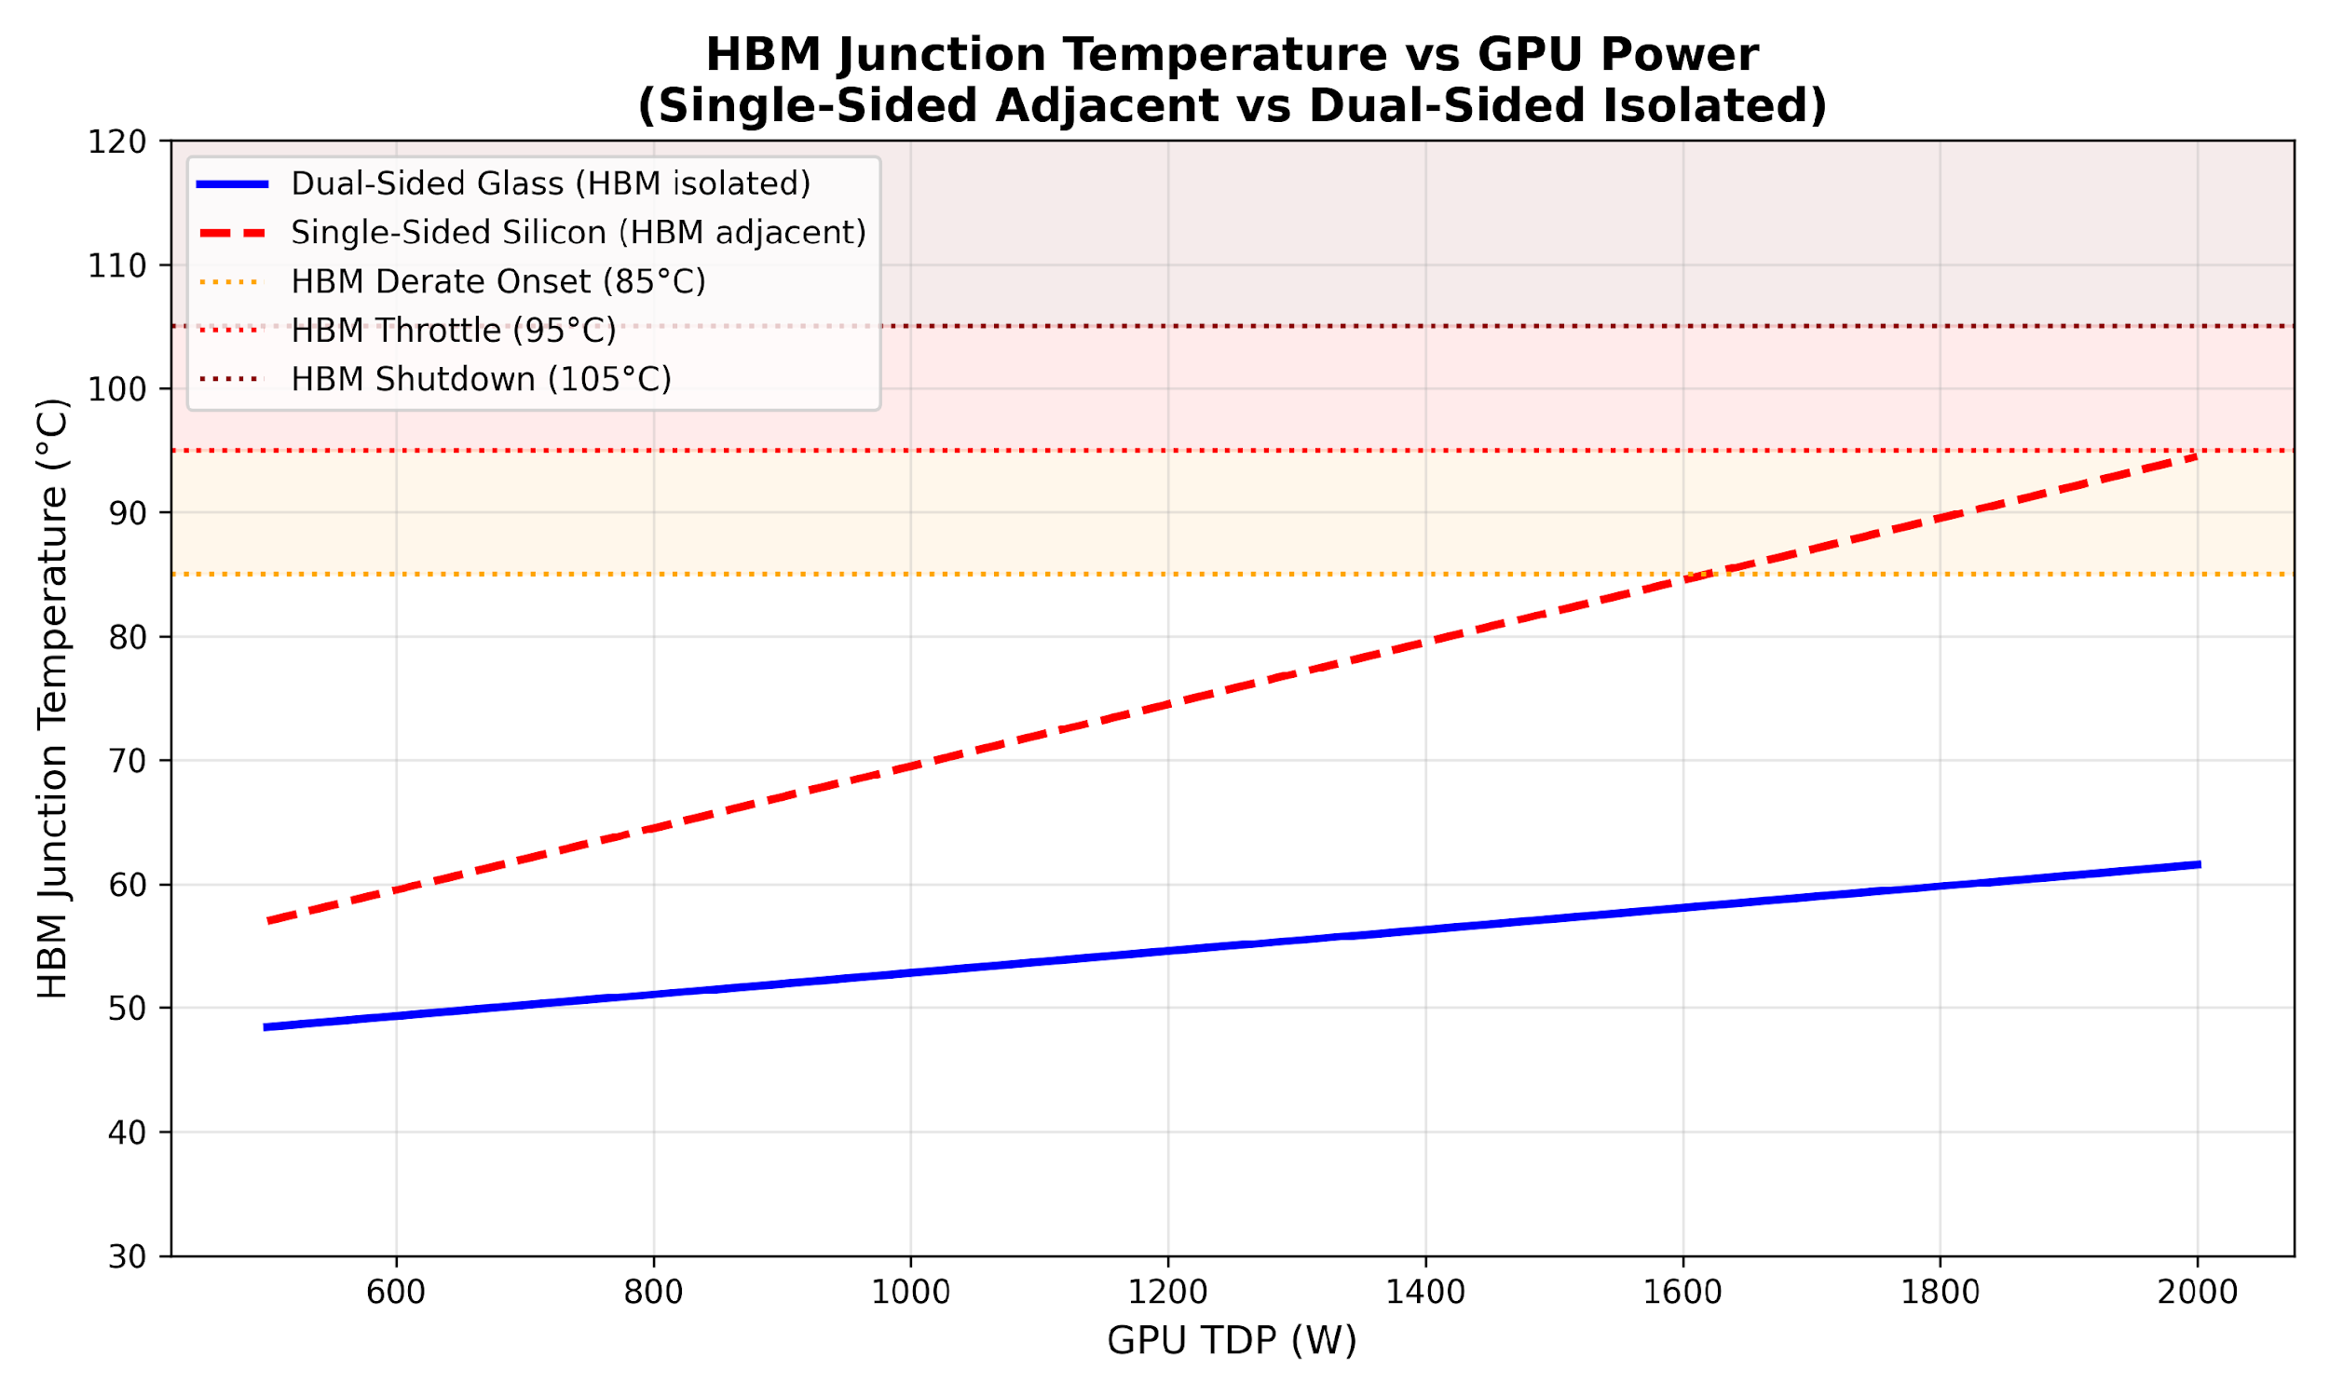
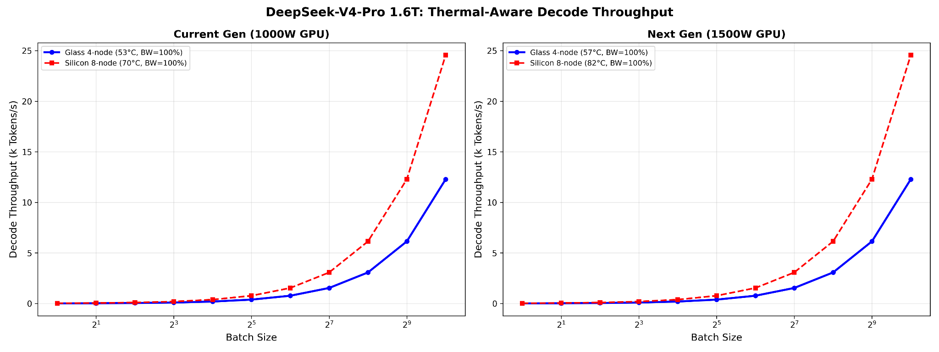
Junda
Glass Substrate: ICCAD -> HPCA / ICCD?
(Sick🫠)
Thermal isolation to system-level throughput impact
Extended Thermal Analysis (2D FEA + Sensitivity)
• 2D steady-state solver confirms glass blocks GPU heat from reaching HBM
◦ Even 10% copper TGV fill does NOT create thermal shorting (good for us)
• Sensitivity sweep {500–1500W} × {0.3–2.0 °C/W} shows glass HBM ≤ 77°C worst

Slide 2
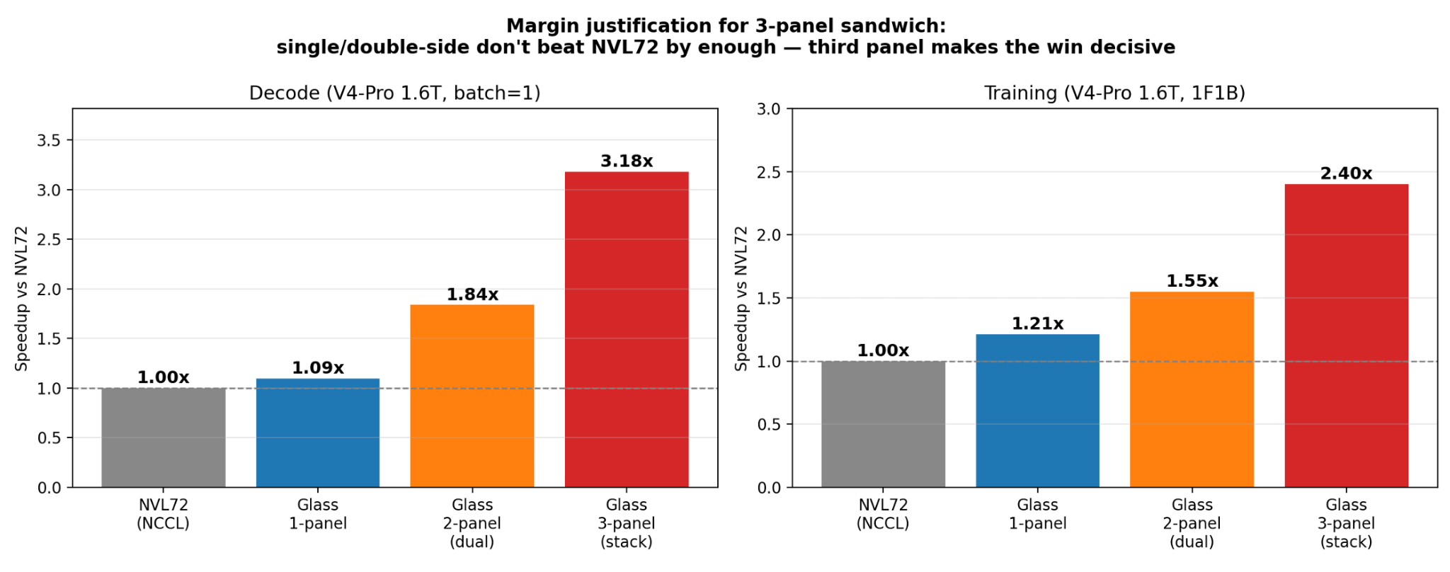
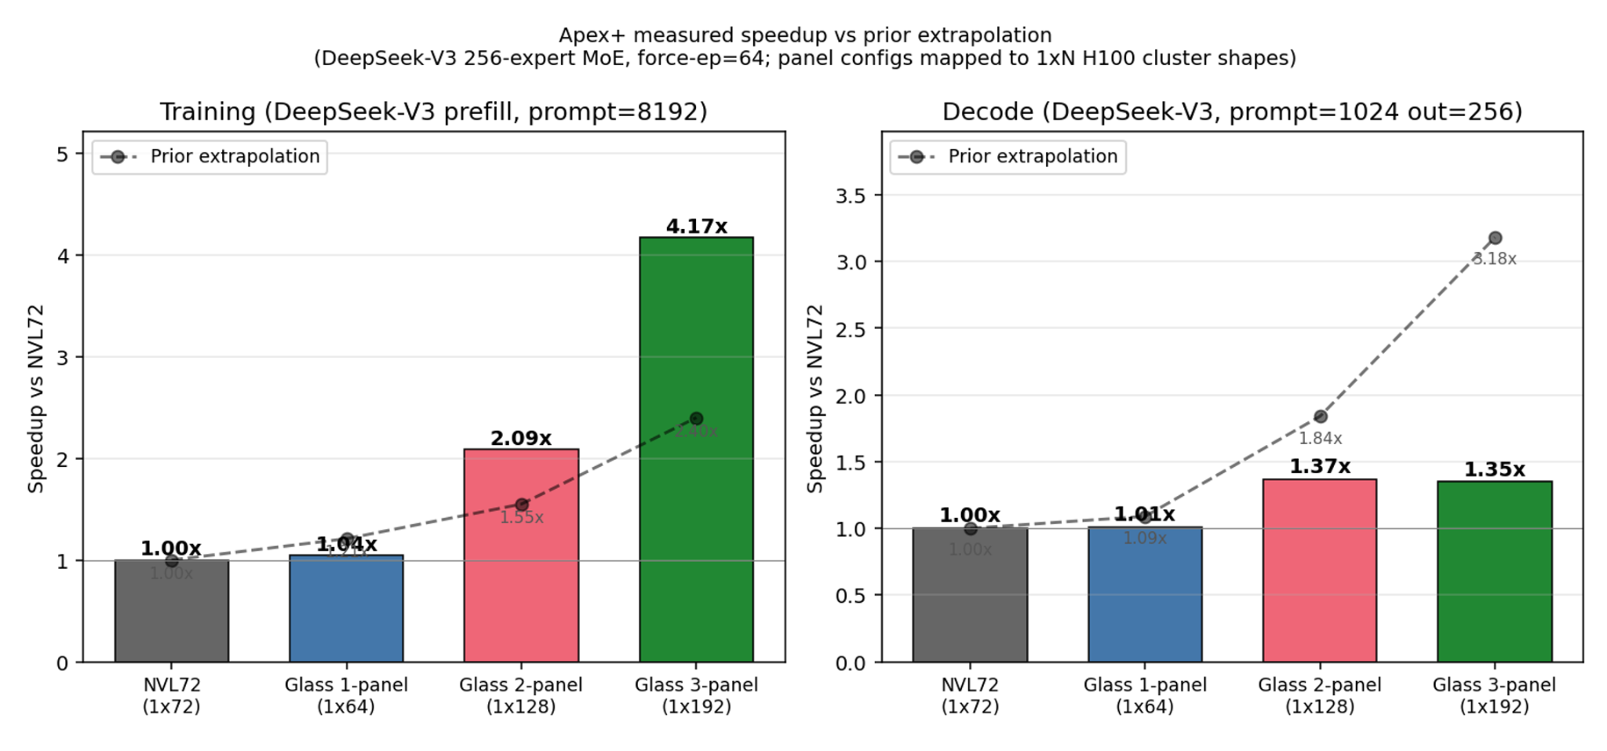
Junda
Glass Substrate: ICCAD -> HPCA / ICCD?
(Sick🫠)
Three-Panel Sandwich — Measured Speedup
• Deepseek-v3 256-expert as DeepSeek-V4-Pro 1.6T analog
• Forced parallelism: --force-ep 64 (training-style TP1 × EP64)
• Panel proxies via num_gpus_per_node:
NVL72 = 1×72,
single = 1×64,
double= 1×128,
3-panel= 1×192
Ours vs NVL72 Baseline
Training (cluster aggregate, fixed-EP MoE):
single 1.04× • double 2.09× • 3-panel 4.17×
Inference (per cluster):
single 1.01× • double 1.36× • 3-panel 1.35×
Decode caveat
*1.35× is pessimistic by simulator construction, not physics.
• Single/double don't win enough vs NVL72; the third panel makes the training delta decisive
Next Steps (In Progress)
◦ Extend throughput sim: 384GB/slot × Kimi-K2/DSV3

Slide 3
Mingjia
World model via long-video gen (Neurips submission)
Robust Action-Conditioned World Modeling for Third-Person Games (Neurips submission)
  Previous works mostly focus on first-person; Third person bring unique challenges: diverse character - env interaction.
  We trained on 5 third-person games, and explore techniques to enable robust action following in long video gen.
Plans:
  More comprehensive experiments / ablation to support our claim
  Need to refine the story and writing (I’ll share the overleaf after I finalize the story.)
  Plan: Arxiv + codebase + data pipeline release mid June.
World model on the Edge
Fixed robotics: One model can do the job (Leapfrog Inference: overlap inference with action)
Movable robotics: Decouple large and small models (AsyncVLA, etc.)
  https://www.nvidia.com/en-us/autonomous-machines/embedded-systems/jetson-thor/ FP4: 2k TFLOPS (vs B300, 15k)
World model with RL training:
Many commercial video gen models have a RL stage (Nvidia Cosmos)
A research that did RL on video models for robotics: Aligning Video World Models with Executable Robot Actions via Inverse Dynamics Rewards
Notes:
Looking ahead -5 - 10 years, need motivation/big picture (may not need solution)
World models/video/audio (robotics also fine) would be more interesting
Focus on training more than inference
Organize and shape the ideas

Slide 4
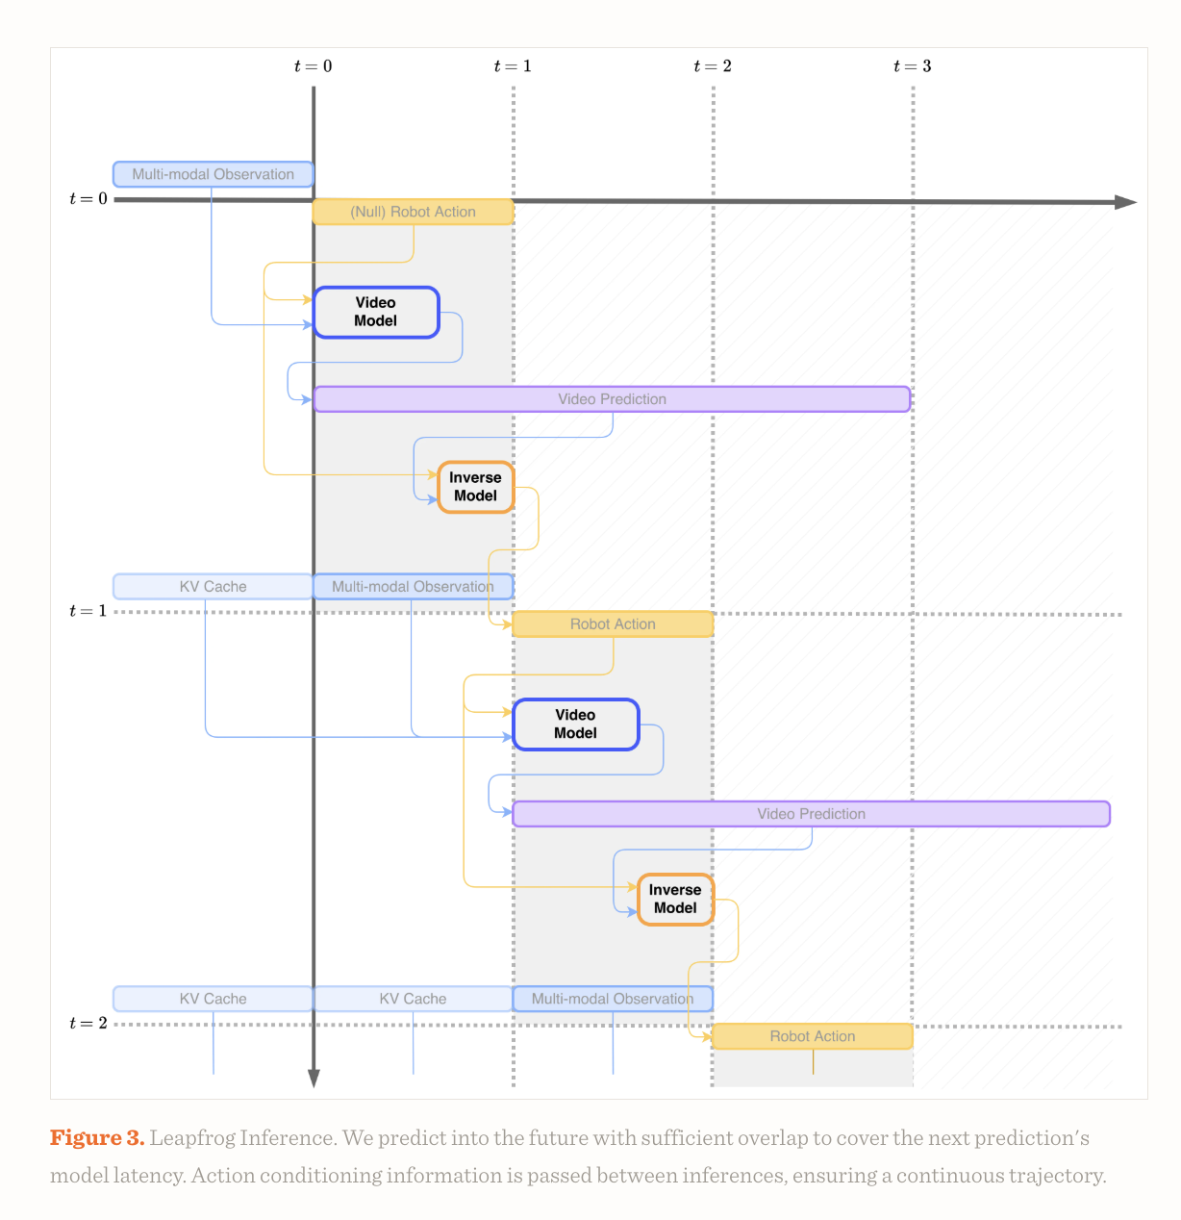
https://www.rhoda.ai/research/direct-video-action

Slide 5
Junda
Glass Substrate: ICCAD -> HPCA / ICCD? (online)
Three-Panel Sandwich — Measured Speedup
• Deepseek-v3 256-expert as DeepSeek-V4-Pro 1.6T analog
• Forced parallelism: --force-ep 64 (training-style TP1 × EP64)
• Panel proxies via num_gpus_per_node:
NVL72 = 1×72,
single = 1×64,
double= 1×128,
3-panel= 1×192
Ours vs NVL72 Baseline
Training (cluster aggregate, fixed-EP MoE):
single 1.04× • double 2.09× • 3-panel 4.17×
Inference (per cluster):
single 1.01× • double 1.36× • 3-panel 1.35×
Decode caveat
*1.35× is pessimistic by simulator construction, not physics.
• Single/double don't win enough vs NVL72; the third panel makes the training delta decisive
Next Steps (In Progress)
◦ Extend throughput sim: 384GB/slot × Kimi-K2/DSV3

Slide 6
Mingjia
World model via long-video gen (Neurips submission)
Long-Horizon Generalization in Third-Person Interactive World Models
  Previous work mostly focus on first person world model
  Significance: Third person world model is a missing piece, while it is important because it generate videos with character-environment interaction.
  Contribution:
    We train third person world model on 5 games that has more realistic physical engine compared with related work.
      Climbing / Swimming / Running / Gliding, etc.
    Progressive long tuning, enabling 30s generation
    KV cache selection based on camera trajectory
    From one-game to five-game OOD generalization behavior.
    Action enhancement techniques: scale action vector; attention injection
World model on the Edge
Continue survey recent works on splitting training/inference between data center and edge

Slide 7
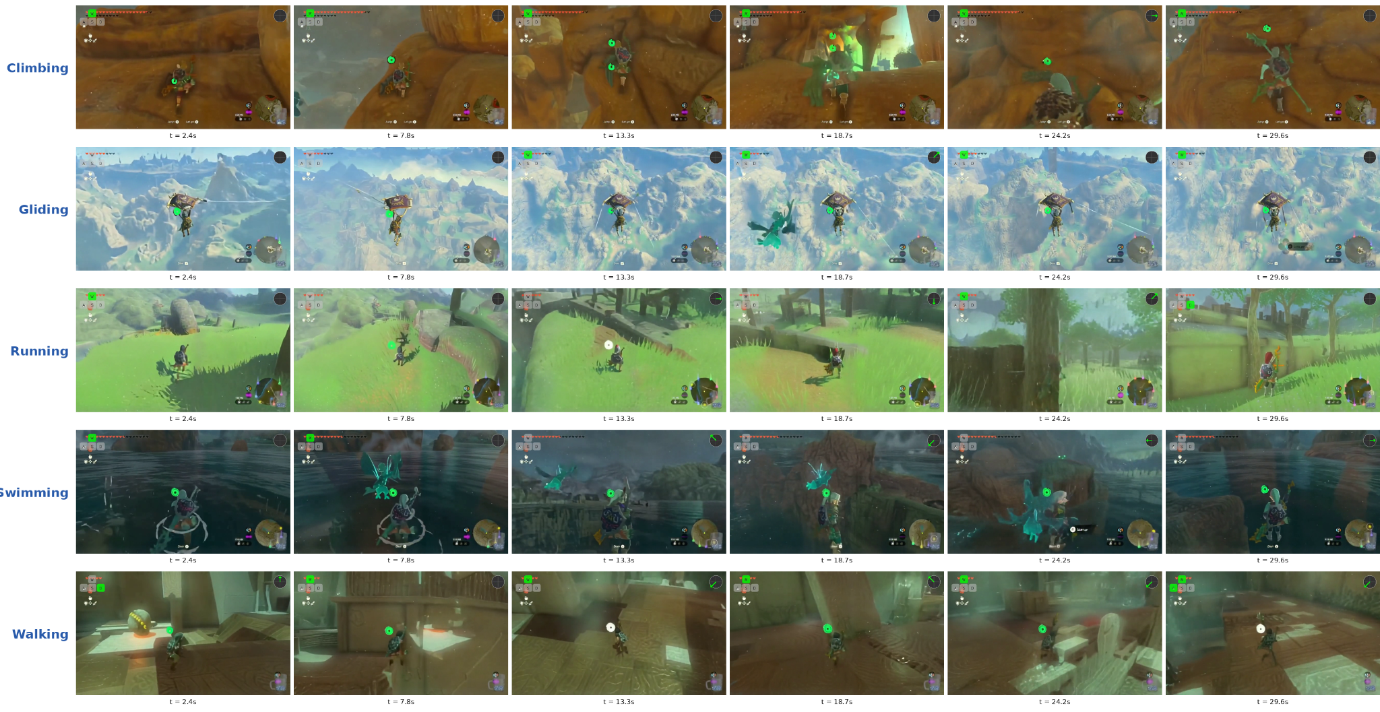

Slide 8
Junda
Glass Substrate: ICCAD -> HPCA / ICCD? (online)
Architecture Options
Dual-Sided Glass Substrate
Option A: Sandwich (recommended)
• GPU top (cold plate) / HBM bottom (passive)
• Low risk, 2× memory, proven thermal isolation
• Novelty: medium — but strong systems-level story
Option D: Hybrid (moon shot)
• GPU top / Embedded PICs in glass / HBM bottom
• First photonic + dual-sided co-design
• High risk, very high novelty → MICRO/ASPLOS scope
Rejected:
• Option B (2× GPU both sides) — 2000W+, can't cool
• Option C (GPU embedded in glass) — thermal trap
• Goal: Place GPU on one side, HBM on the other side
◦ Glass κ ≈ 1 W/m·K → acts as thermal barrier (R ≈ 938 °C/W)
◦ At 1000W GPU: <0.6W leaks to memory side (<1°C rise)
◦ Compare Si interposer (κ=130): 7× worse thermal coupling
• Georgia Tech PRC demonstrated dual-sided glass [TCPMT'14, '16]
◦ 30-100µm glass, 30µm Cu TGVs, dual-side RDL (1-2µm L/S)
◦ Gap: nobody tested GPU-class TDP or photonic co-design
• Memory per slot: 192 GB → 384 GB (12× HBM3E both sides)
◦ Kimi-K2 (4TB): 21 → 11 slots needed (48% fewer, no weight dup)
References
• [TCPMT'14] Sukumaran et al., "Ultrathin 3D Glass Interposers w/ TPVs"
• [TCPMT'16] Kumar et al., "PDN Resonance in Double-Sided 3D Glass"
• [TCAD'25] Vanna-Iampikul et al., "Glass Interposer PPA + SI/PI"
• [ECTC'24] Fujimoto (DNP), "Glass Core Stress + Reliability"
• [ECTC'25] Sunohara (Shinko), "Glass Core Build-up w/ TGV"
• [JOM'24] Gupta et al., "SimTEC in Glass for Photonic Packages"
Next Steps (In Progress)
◦ Build thermal cross-section simulator (Python)
◦ Extend throughput sim: 384GB/slot × Kimi-K2/DSV3
◦ Share 1-pager with advisor; decide paper scope
Notes:
Industry Landscape
• Georgia Tech PRC: dual-sided glass demo (low power)
• Intel: $1B+ glass substrate R&D, production ~2027
• Samsung: triple-subsidiary glass effort, pilot 2026-27
• Absolics (SKC): GA factory built, CHIPS Act funded
• ECTC'25: "Glass Core vs RDL Interposer" special session
Our gap to fill:
◦ Thermal feasibility at GPU-class TDP (>300W)
◦ Architecture study for MoE LLM workloads
◦ Photonic mesh + dual-sided co-design

Slide 9
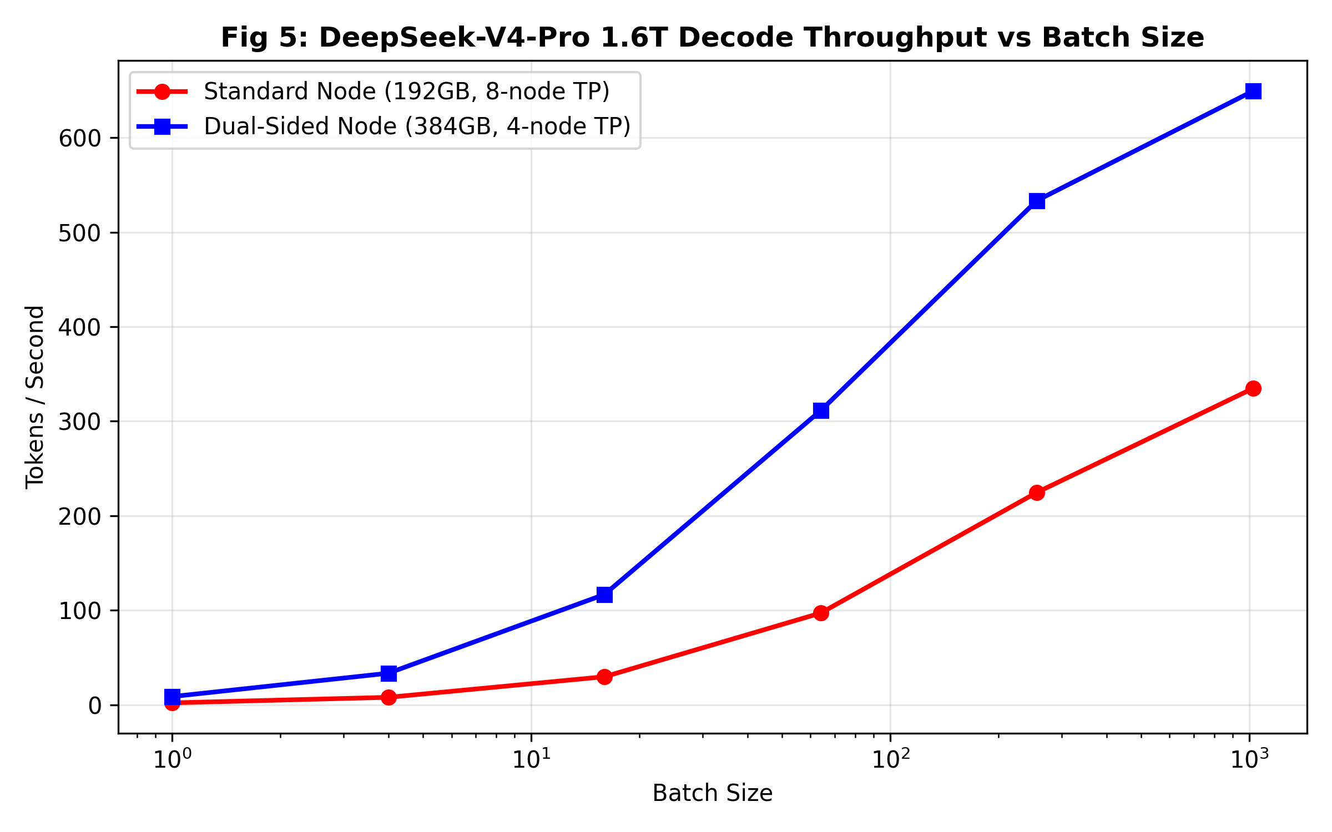
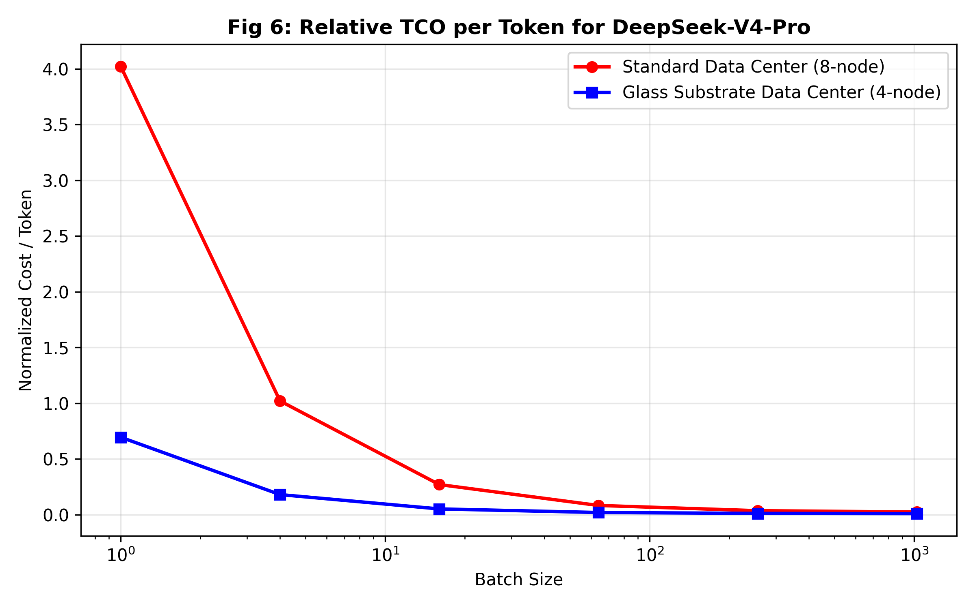
Goal: Quantify DeepSeek-V4-Pro (1.6 Trillion Parameter) MoE Decoding
• The 1.6T parameter MoE model requires ~1.6TB memory footprint (FP8)
◦ Standard node (192GB) forces massive 8-way Tensor Parallelism
◦ Dual-sided node (384GB) fits the model shard in just 4-way Tensor Parallelism
Network Overhead Reduction
• Shifting from 8-way to 4-way TP drastically cuts inter-node All-Reduce communication
◦ Model throughput (Tokens/sec) jumps significantly, particularly at low batch sizes
◦ Results in a massive reduction in Total Cost of Ownership (TCO) per token

Slide 10
Mingjia
 | Flash attn | SP all2all
Latent len = 40 | 367 ms | 36 ms
Latent len = 80 | 1350 ms | 116.5 ms
World model via long-video gen
Recall that 1 latent frame ~ 1.5k tokens ~ 0.16s
  Then 1s ~ 10k tokens => Easy to hit memory capacity limit
Inference: SP takes significant time for real time causal inference
Training:
  Finetune: Compute increase faster than communication (compute grow quadratically, see above table on nvl72 with SP=12)
  RL / self distillation (a good point to target):
    https://arxiv.org/html/2512.15840v1 Large Video Planner Enables Generalizable Robot Control
      Long-horizon planning for robotics by training video generation models
      RL is critical for training robot policy
    Since rollout can use rolling kv cache, the compute can grow linearly with generation length, instead of quadratically.
    Profiling the memory capacity for distillation with SP=1:
      3 latent training: 55 GB peak
      9 latent training: 135 GB peak
      15 latent training: OOM
Notes:
ML models that have little communication / only periodic communication between robot and data center.
Dinesh Bharadia / Xiaolong Wang / Nikolay
https://arxiv.org/pdf/2602.13476

Slide 11
Junda
Glass Substrate: ICCAD -> HPCA / ICCD? (online)
Architecture Options
Dual-Sided Glass Substrate
Option A: Sandwich (recommended)
• GPU top (cold plate) / HBM bottom (passive)
• Low risk, 2× memory, proven thermal isolation
• Novelty: medium — but strong systems-level story
Option D: Hybrid (moon shot)
• GPU top / Embedded PICs in glass / HBM bottom
• First photonic + dual-sided co-design
• High risk, very high novelty → MICRO/ASPLOS scope
Rejected:
• Option B (2× GPU both sides) — 2000W+, can't cool
• Option C (GPU embedded in glass) — thermal trap
• Goal: Place GPU on one side, HBM on the other side
◦ Glass κ ≈ 1 W/m·K → acts as thermal barrier (R ≈ 938 °C/W)
◦ At 1000W GPU: <0.6W leaks to memory side (<1°C rise)
◦ Compare Si interposer (κ=130): 7× worse thermal coupling
• Georgia Tech PRC demonstrated dual-sided glass [TCPMT'14, '16]
◦ 30-100µm glass, 30µm Cu TGVs, dual-side RDL (1-2µm L/S)
◦ Gap: nobody tested GPU-class TDP or photonic co-design
• Memory per slot: 192 GB → 384 GB (12× HBM3E both sides)
◦ Kimi-K2 (4TB): 21 → 11 slots needed (48% fewer, no weight dup)
References
• [TCPMT'14] Sukumaran et al., "Ultrathin 3D Glass Interposers w/ TPVs"
• [TCPMT'16] Kumar et al., "PDN Resonance in Double-Sided 3D Glass"
• [TCAD'25] Vanna-Iampikul et al., "Glass Interposer PPA + SI/PI"
• [ECTC'24] Fujimoto (DNP), "Glass Core Stress + Reliability"
• [ECTC'25] Sunohara (Shinko), "Glass Core Build-up w/ TGV"
• [JOM'24] Gupta et al., "SimTEC in Glass for Photonic Packages"
Next Steps (In Progress)
◦ Build thermal cross-section simulator (Python)
◦ Extend throughput sim: 384GB/slot × Kimi-K2/DSV3
◦ Share 1-pager with advisor; decide paper scope
Notes:
Industry Landscape
• Georgia Tech PRC: dual-sided glass demo (low power)
• Intel: $1B+ glass substrate R&D, production ~2027
• Samsung: triple-subsidiary glass effort, pilot 2026-27
• Absolics (SKC): GA factory built, CHIPS Act funded
• ECTC'25: "Glass Core vs RDL Interposer" special session
Our gap to fill:
◦ Thermal feasibility at GPU-class TDP (>300W)
◦ Architecture study for MoE LLM workloads
◦ Photonic mesh + dual-sided co-design

Slide 12
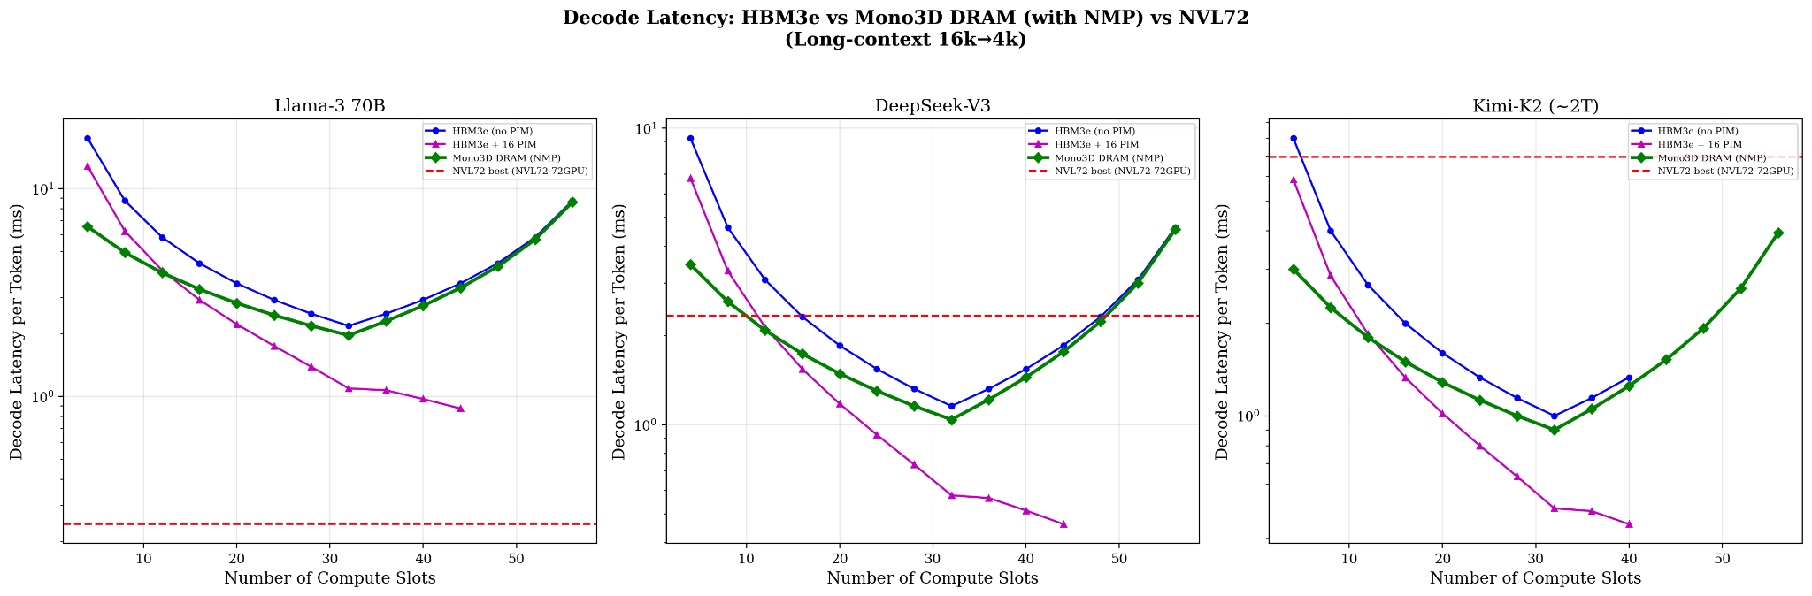
Junda
Glass Substrate: ICCAD -> HPCA / ICCD?
Panel-Scale MoE Routing Algorithm
Next Step 1: Panel-Scale Heterogenous System
• Basically back to these slides (1), (2)
• Think about the algorithm with heterogenous hardwares at the same time.
Why deadline is not met:
◦ Changing algorithm and some architecture assumption not aligned
◦ Energy consumption number.
✅What’s done
◦ Simulator (training and inference) and simulation
◦ MoE routing traces on Qwen35B (smaller) and Qwen235B (larger) MoE
◦ Conversation: ShareGPT
◦ Coding: Code bench
What’s good to have (in progress)
◦ Long context traces: Prolong {64k, 512k}
◦ Due to resource constraint this runs slower
Need Help
◦ Next step?
Next Step 2: Cross-Panel-Scale Heterogenous System
• Start simulation on cross-panel scale on training.
• What’s doable?
◦ Cross-panel reconfiguration cost?
• What’s the blocker?
◦ Cross-panel reconfiguration cost
◦ Energy consumption

Slide 13
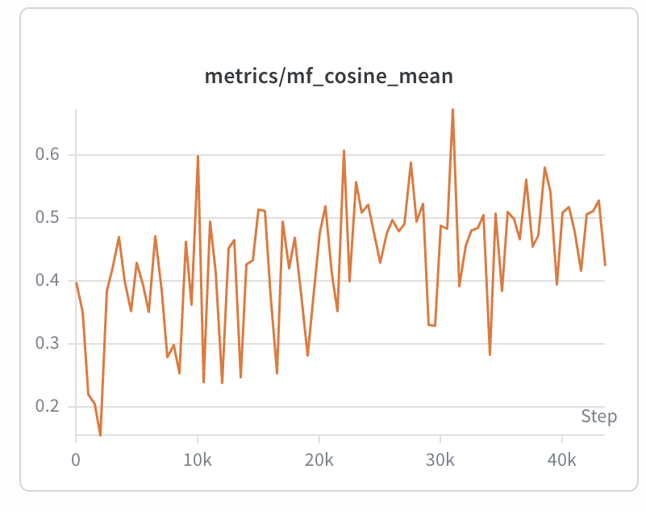
Mingjia
World Model Training
long video generation
  Recall the pipeline: bidirectional finetune (bidirectional, 50 steps) => diffusion forcing (causal, 50 steps) => self forcing (causl, 4 steps)
  Trained diffusion forcing and self forcing on longer rollouts (still running)
    Simply change the number of latents for diffusion forcing
    For self forcing, given the 9-latent-frame teacher, ask the student to generate 18-latent-frame (or longer) rollouts, and ask the teacher to supervise the first and second half.
  Found recent paper actually train on long video (1 min) with full kv cache
    Mode Seeking meets Mean Seeking for Fast Long Video Generation use SP while training
OOD generation
  Mix the MC and Zelda third-person data and observed better OOD generation results
    The figure shows the OOD performance on action following get improved when training on MC+Zelda data.

Slide 14
Junda
Head-down mode on engineering + simulation
ICCAD: Panel-Scale MoE Routing Algorithm
Paper Framing
• Core contribution: mitigate cross-node EP communication within panel
◦ Glass substrate enables flexible all-to-all without multi-hop chaining
◦ Framed as routing decomposition — a matrix separation architecture
• Baseline: 8x H100 intra-node (strong, realistic, widely deployed)
◦ Panel makes H100-scale EP work — that is the claim
• Workload: Qwen3-235B-A22B (agentic inference, short-context decode)
◦ Profiled via offline prefill — routing matrices dumped without engine hacks
This paper: can the panel architecture make H100-level EP routing work?
• Yes — via routing decomposition + flexible panel switching
• Reasonable parallelism strategy for Qwen3-235B (64 experts):
◦ EP=64 primary (cross-node, 1 expert/node)
◦ TP=4, EP=16 alternative (to justify agentic workload setup)
◦ No PP — keeps simulation tractable for now
• Simulation via apex with H100 comm model as ground truth
Why NVL72 Is not our main selling point
Action Points (In Progress)
• No aggregate bw gain compared with NVL72 (latency basically same)
• Switch reconfiguration cost eats even more the network-side benefit
• Energy is not dominant factor to illustrate.
• Heterogenous architecture is hard to build (for now)
H100 comparison will be the main one.
◦ NVL72 comparison will be a side comparison, which foreshadows our next paper on heterogeneous architectures.
◦ Requires heterogeneous HW (compute + memory disaggregation) to realize gains
✅ Generate routing heatmaps for Qwen3-35B-A3B
✅ Run apex simulation — H100 cross-node baseline vs. panel (EP=64 prefill throughput as primary result)
⌛Generate routing heatmaps for Qwen3-235B-A22B
• Next paper (separate): heterogeneous panel — compute + memory disagg, so we can actually beat NVL72 on BW and energy

Slide 15
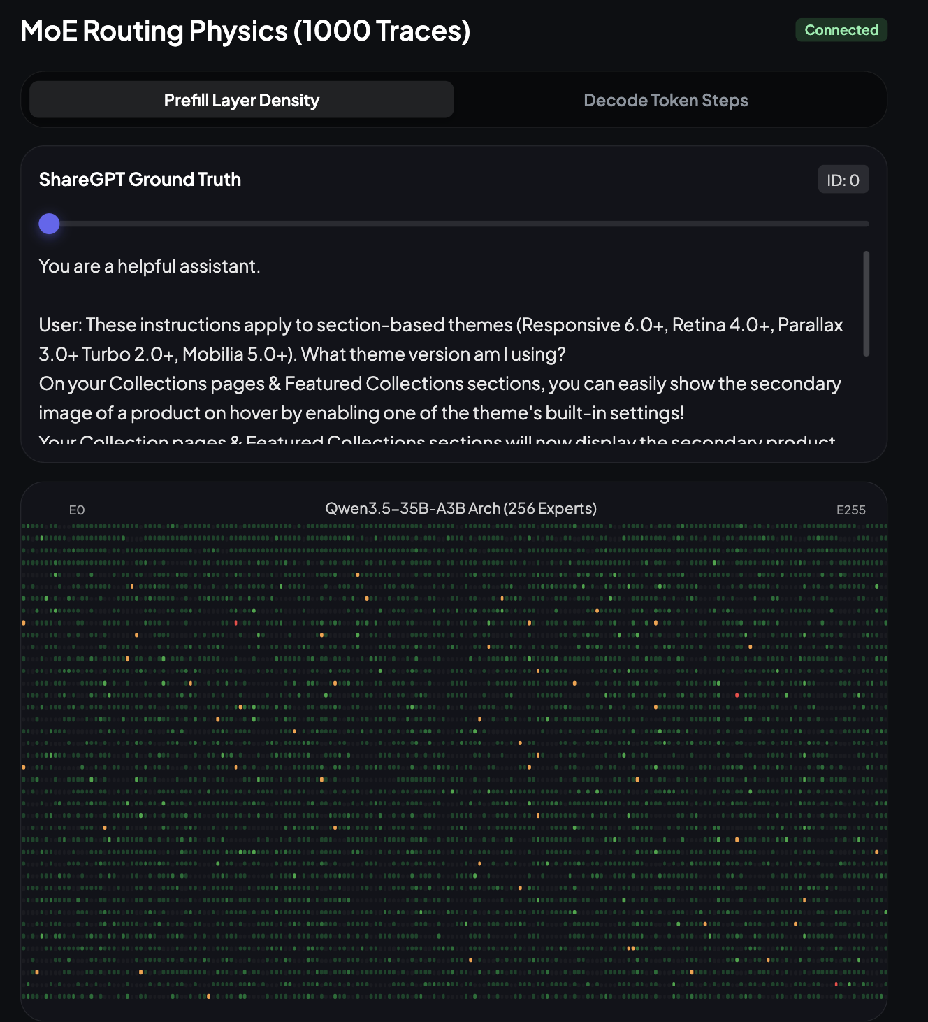
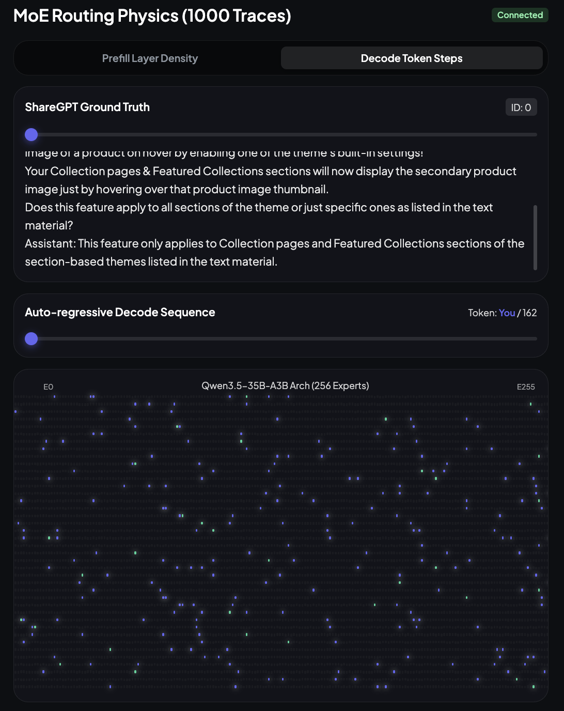

Slide 16
Junda
Glass substrate; (sick & online)
Head-down mode to engineering + measurement
Realistic MoE Communication Routing
• Goal: Understand the divergence of
• Previously: ideal case analysis (uniform all-to-all, max P2P bandwidth)
• Now: setting up configurations that match real MoE inference deployments
◦ Similar scale to Qwen3.5-35B-A3B → Qwen3.5-397B-A17B
◦ Prefill: {32K, 64K, 128k, .. ,1M} context
◦ Decode: shorter context for now (to justify disaggregation in this setup)
• Reasonable Parallelism Strategy on 72-card setup:
◦ Prefill pool: {16,32,48,64} GPU, grouped in {4, 8} for ingestion
◦ Decode pool: remaining cards, set EP={4,8,16}
◦ DP instances fill the rest
• Workload
◦ Agentic workload
Next Steps (In Progress)
◦ Get the actual number from NVL72 cluster → real network perf (NCCL)
◦ Plug matrix into scheduling simulator (SPECTRA integration) as baseline
◦ Compare realistic comm overhead vs our ideal-case numbers from before
Working closely with Yue to iterate the engineering part.
Expert-to-Expert Traffic Matrix (Not All-to-All)
• Static all-to-all overestimates real network load — ignores routing locality
• Approach: extract actual router_logits from HuggingFace MoE forward pass
◦ Build empirical [Expert_i → Expert_j] payload matrix
◦ Profile at virtual Expert ID level (decouple from physical rank placement)
• Result feeds into Yue's physical mapping optimization on the glass mesh

Slide 17
Junda
GTC this week; Glass substrate → MICRO/ICCAD
GTC 2026: Vera Rubin + Groq 3 LPU
Glass Scheduling/Routing Solved
Rubin GPU: 288 GB HBM4, 22 TB/s mem BW, 3.6 TB/s NVLink 6
• NVL72: 20.7 TB total, 260 TB/s scale-up, 3.6 EFLOPS FP4
• Power: 2.3 kW/GPU (was ~1 kW for B200)
Groq 3 LPU: decode-only chip (acquired by NVIDIA)
• 500 MB SRAM, 150 TB/s BW, 1.2 PFLOPS FP8 per chip
• 256 LPUs/rack = 128 GB SRAM, 640 TB/s
• GPU does prefill + attn; LPU does FFN/MoE decode
• Claim: 35× inference throughput/MW vs Hopper
• Key insight: XY circuits → permutation decomposition
◦ Bottleneck = GPU interface (7TX + 7RX), NOT cross-links (126 WGs)
◦ No fancy routing — just route X-then-Y for each entry
• Non-MoE: precomputed from training code (offline, deterministic)
• MoE: random orthogonal set of N−1 permutations
◦ Generate once → reuse for any MoE; only recompute durations dk
◦ Max channel load: 40–75 WGs (capacity: 126) → 40–68% headroom
Glass vs Vera Rubin: What Changed
SPECTRA Algorithm [arXiv:2603.07373]
Advantages that survive:
◦ No weight duplication (shared memory pool)
◦ Optical multicast (NVLink still unicast)
◦ 10–50ns latency (NVLink still ~1–5 μs)
◦ MoE routing near-zero overhead
Gap narrowed:
◦ Rubin HBM4 22 TB/s vs our HBM3e 8 TB/s
◦ NVLink 6 3.6 TB/s vs our optical 2 TB/s
• Bill Lin + Isaac Keslassy's paper (our collaborators)
• 3-step: Decompose → Schedule → Equalize
◦ Decompose: D → k permutations (König's thm: k = min possible)
◦ Schedule: assign perms to s switches via LPT (least-loaded)
◦ Equalize: split large perms for load-balance across switches
• Results: 1.4× (GPT), 1.9× (MoE), 2.4× (benchmark) vs baseline
• MoE traffic easier to schedule than sparse GPT (good for us)
• Runtime: <14ms — negligible vs 7μs switch reconfig
Our innovation:
(1) SPECTRA + XY circuits → provably works on our 2D photonic mesh
(2) MoE routing prediction → D matrix can be constructed fast enough
Next Step Questions?
◦ Understand the energy gap at 8x8 case – for paper, it make sense?
◦ Should we still compare to Blackwell, or we should compare to VR?
Notes:
Refs
Intro-glass-1, intro-glass-2, intro-glass-3

Slide 18
Mingjia
Google NDA email?
TILOS foundations faculty: https://tilos.ai/research/foundations/
World Model Training
Run diffusion forcing (start from a finetuned 50-step bidirectional model, and turn it into a 50-step causal model)
  Trained 30k steps, observed that video quality and action mostly preserved
  Error accumulation due to the causality (expected)
    Reason: During training, we infer next block based on noisy ground truth latents of previous blocks; but during inference, we infer next block based on predicted latents of previous blocks
      a training/inference mismatch
  Will run self-forcing to reduce denoising steps from 50 steps to 4 steps, and mitigate error accumulation
Video gen profiling
Video gen training is similar to long-context LLM training
Video gen inference
  Long video inference: compute explode, so people do kv-cache compression to make it shorter
  World model inference (low latency): seq parallel can cause communication overhead
Preprocessing:
  Since training is based on latents, people will preprocess the videos into latents using VAE before training, could also takes much time
    Storage - GPU communication: 1TB read and write

Slide 19
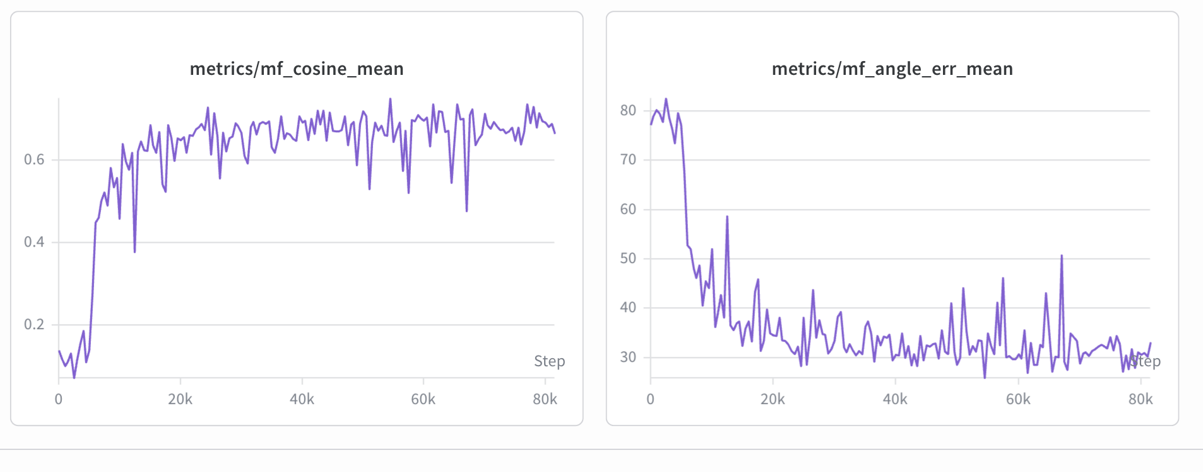
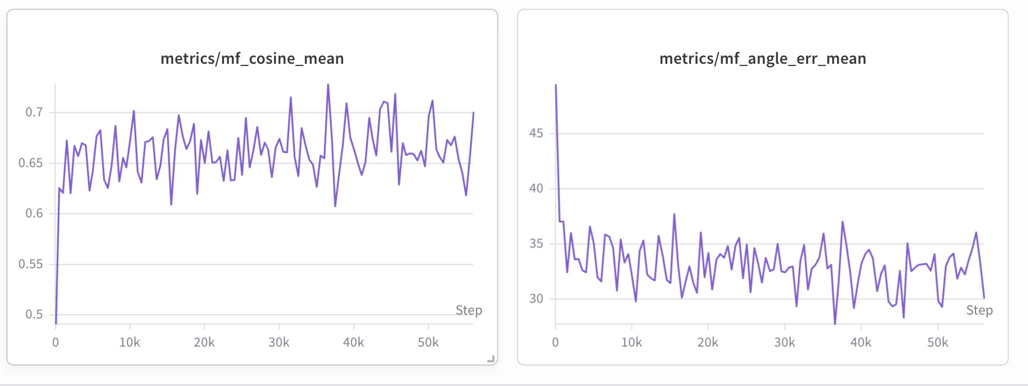
Mingjia
Metrics during training for bidirectional finetuning
Metrics during training for diffusion forcing
https://drive.google.com/file/d/1xVkwXhgYDL8bHzplJM_4ZNkJO5ejD5dL/view?usp=sharing a sample generated video

Slide 20
Junda
KV3D DAC rejected :( → resubmission ISPLED
Major complaint (3431): review
  (1) Lack real hardware measured number;
  (2) System part hard to separate the algorithm from traditional sched algorithm (→ improve writing)
Glass substrate (w/ David + Mingjia) → Micro April? [260B$]
NSF 2 paragraph Draft (today)
Training
  Scale-out network does consume most of the time of communication in training
    MoE: all-to-all (up to 20-55% [MixNet]);
    All models: AllReduce for param gathering;
  Theoretic speedup: Our bandwidth / NVLink bandwidth
Inference
  Optical reconfiguration latency is the major determining factor for our gain
  Three switching technologies compared:
    MEMS (~10–25 ms): mechanical micromirrors, too slow for MoE decode
    Microring Resonator (~1–100 μs): thermal tuning, practical for batched transfers
    MZI (~2–10 ns): electro-optic, fast enough for per-message reconfiguration but high insertion loss
  Reconfiguration efficiency analysis: at WDM 1.6 Tb/s, MRR gives only 39% efficiency; MZI gives 98.5%
  Q: Which one should we use? → Meeting at Wed to understand arch & hardware more
Next Step
  NSF 2 paragraph Draft (today)
  MLSys Artifact Evaluation + Camera Ready Paper + Presentation (Thursday)
Notes:
Refs
Intro-glass-1, intro-glass-2, intro-glass-3

Slide 21
Text heavy!
Waveguide Routing Optimization (w/ thought process)
Problem Definition 1 - [Single-round planning]
Given an n×n grid of GPU nodes, route a (skewed) comm matrix to minimize makespan (all-to-all)
  min max_{(i,j)} T_{i,j} – minimize time of last-finishing flow
Conjectured NP-hard (subsumes multi-commodity flow + contiguous path constraints)
Drawback: Only one-hop planning – we don’t have enough optimal waveguide!
Problem Definition 2 - [Multi-round planning]
Given n×n grid of nodes, route R rounds of comm minimize makespan (all-to-all)
  min (sum reconfig_{t} + sum max_{(i,j)} T_{t,i,j} ) – minimize time of entire flow
Opportunities:
  Overlap some comp w/ comm: useful in training, not in inference
Related works
Chronos: Prescheduled circuit switching for LLM training: ~32% faster over packet switching (DCQCN).
  answers what to send when – but not how to route it through a mesh
  Only applied on optical crossbar, not 2D Mesh – which is our opportunity to improve.
Notes:
Questions to project: what is possible today, what is limited by today, at what cost to control each switch, what do we anticipate in 5-10 years
Switch can be localtize

Slide 22
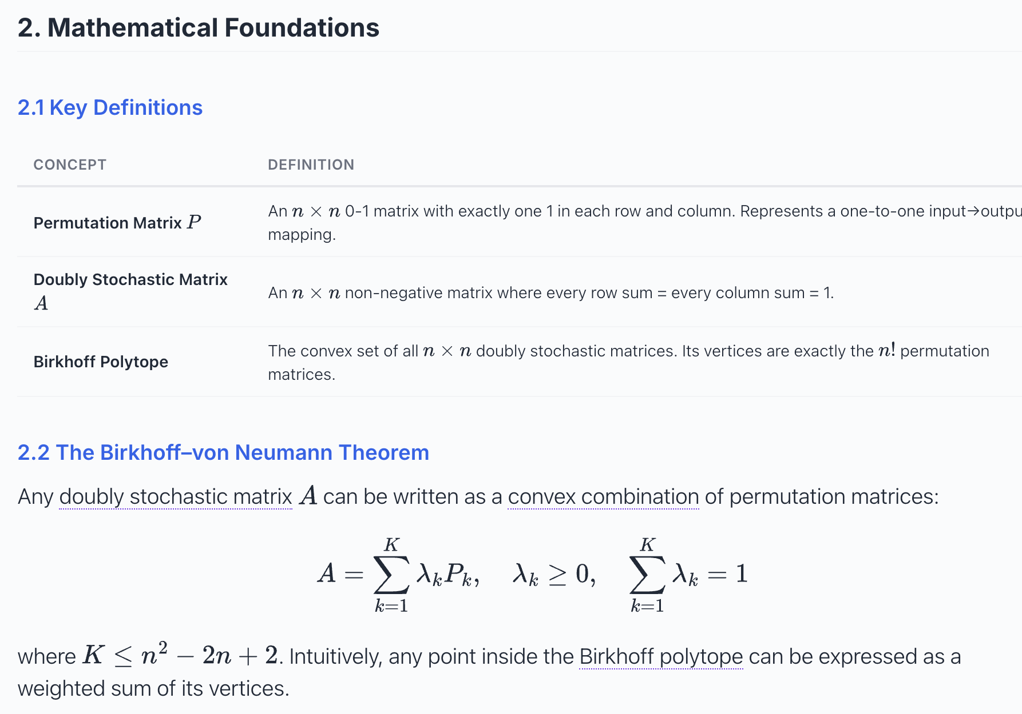
Any doubly stochastic matrix can be decomposed into a weighted sum of permutation matrices.

Slide 23
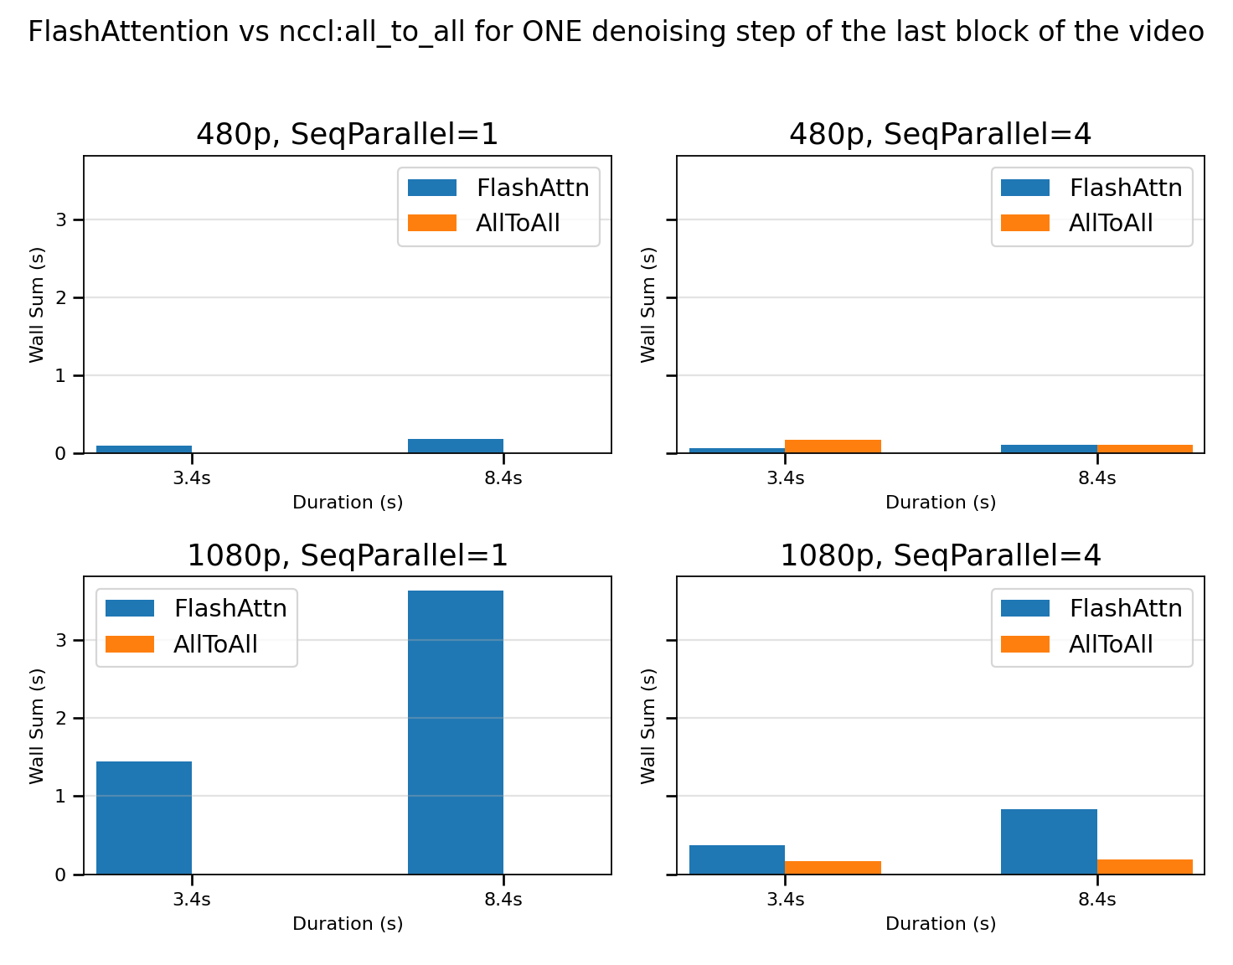
Mingjia
Measurement of video gen of various generation length
Wan1.3B causal with block size=3 latent frames
Flash attention 4
B200 (1 GPU or 4 GPU for Seq Parallel)
Measurement is on ONE denoising step (in total 4 steps) when generating the last block (where kv cache is the largest)
World Model Training
Applied diffusion forcing to convert a bidirectional model to autoregressive model and train 20k steps, video gen / training stability is getting better
Applied self forcing to the ckpt of diffusion forcing, still monitoring the result
Meanwhile, build evaluation benchmark using action flow, so we don’t need to eye bow the validation videos, and can refer to the auto metrics to decide model performance.

Slide 24
Junda
Glass substrate (w/ David + Mingjia) → Micro April? [260B$]
Mostly on aligning sim <> real.
Story 1: Latency-sensitive inference & memory capacity-bound workloads in LLM → Micro
  Network Bandwidth (across-switch): best case 20TB/s P2P, worst case 2.5TB/s P2P
    2.5TB/s worst case – one “light fiber can only accommodate one P2P at a time (in one row)”
    Question: can we achieve the best case?
  Network Latency: 10-50 ns optical hop vs 1-5μs NVLink
    Mostly software latency – cannot do this by profiling!
Story 2: Training for large-scale (100k) GPU of LLM (compute / memory / network)
  Environment: H100 GPU DGX, intra-node NVLink (900GB/s), cross-node Infiniband (100GB/s)
  Bottleneck:
    Network (all-to-all) could become the bottleneck (up to 20-55% [MixNet]) when training MoE models.
  Harder to show a 10x number. Not sure how do we compare
Focus on inference for Micron submission?
Next Step
  1/3/5/10-year trajectory predictions
  Network bandwidth: can we achieve the best case and how?
Misc
KV3D DAC rejected :( → resubmission ISEPED
NeurIPS reimbursement still not coming through?
Notes:
Refs
Intro-glass-1, intro-glass-2, intro-glass-3

Slide 25
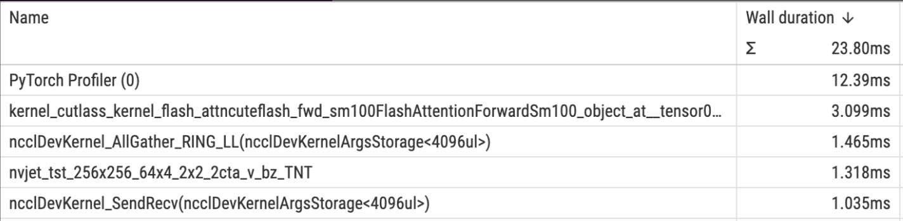
Mingjia
World Model Training
  What we have achieved: Wan2.1-1.3B + Hyworld-action-module + MC-synthetic-data
  Past week:
    Try with Lingbot-action-module (less compute needed), but it can not learn the camera well
    Try with Zelda data from real players. Since the data is much noisier, the performance is not as good, and I am trying with data filtering and rebalance techniques
    Added a automatic method to automatically detect the consistency of provided action and the generated video
  Todo:
    Continue on Zelda training
Video gen co-design
  Training profiling on 4 80GB H100: Wan-14B under sp=4, batch size = 2, hsdp shard = 4
    MFU ~ 40% for backward / forward; 76% for self-attn (which takes 28% of single layer forward)
  Inference profiling
    SP=4
    Precision: FP4
Notes:
Training: break down the MFU
Inference: a longer video

Slide 26
Junda
Glass substrate (w/ David + Mingjia) → Micro April? [260B$]
Mostly on aligning sim <> real.
Story 1: Latency-sensitive inference & memory capacity-bound workloads in LLM → Micro
  Network Bandwidth (across-switch): best case 20TB/s P2P, worst case 2.5TB/s P2P
    2.5TB/s worst case – one “light fiber can only accommodate one P2P at a time (in one row)”
    Question: can we achieve the best case?
  Network Latency: 10-50 ns optical hop vs 1-5μs NVLink
    Mostly software latency – cannot do this by profiling!
Story 2: Training for large-scale (100k) GPU of LLM (compute / memory / network)
  Environment: H100 GPU DGX, intra-node NVLink (900GB/s), cross-node Infiniband (100GB/s)
  Bottleneck:
    Network (all-to-all) could become the bottleneck (up to 20-55% [MixNet]) when training MoE models.
  Harder to show a 10x number. Not sure how do we compare
Focus on inference for Micron submission?
Next Step
  1/3/5/10-year trajectory predictions
  Network bandwidth: can we achieve the best case and how?
Misc
KV3D DAC rejected :( → resubmission ISEPED
NeurIPS reimbursement still not coming through?
Notes:
Refs
Intro-glass-1, intro-glass-2, intro-glass-3

Slide 27
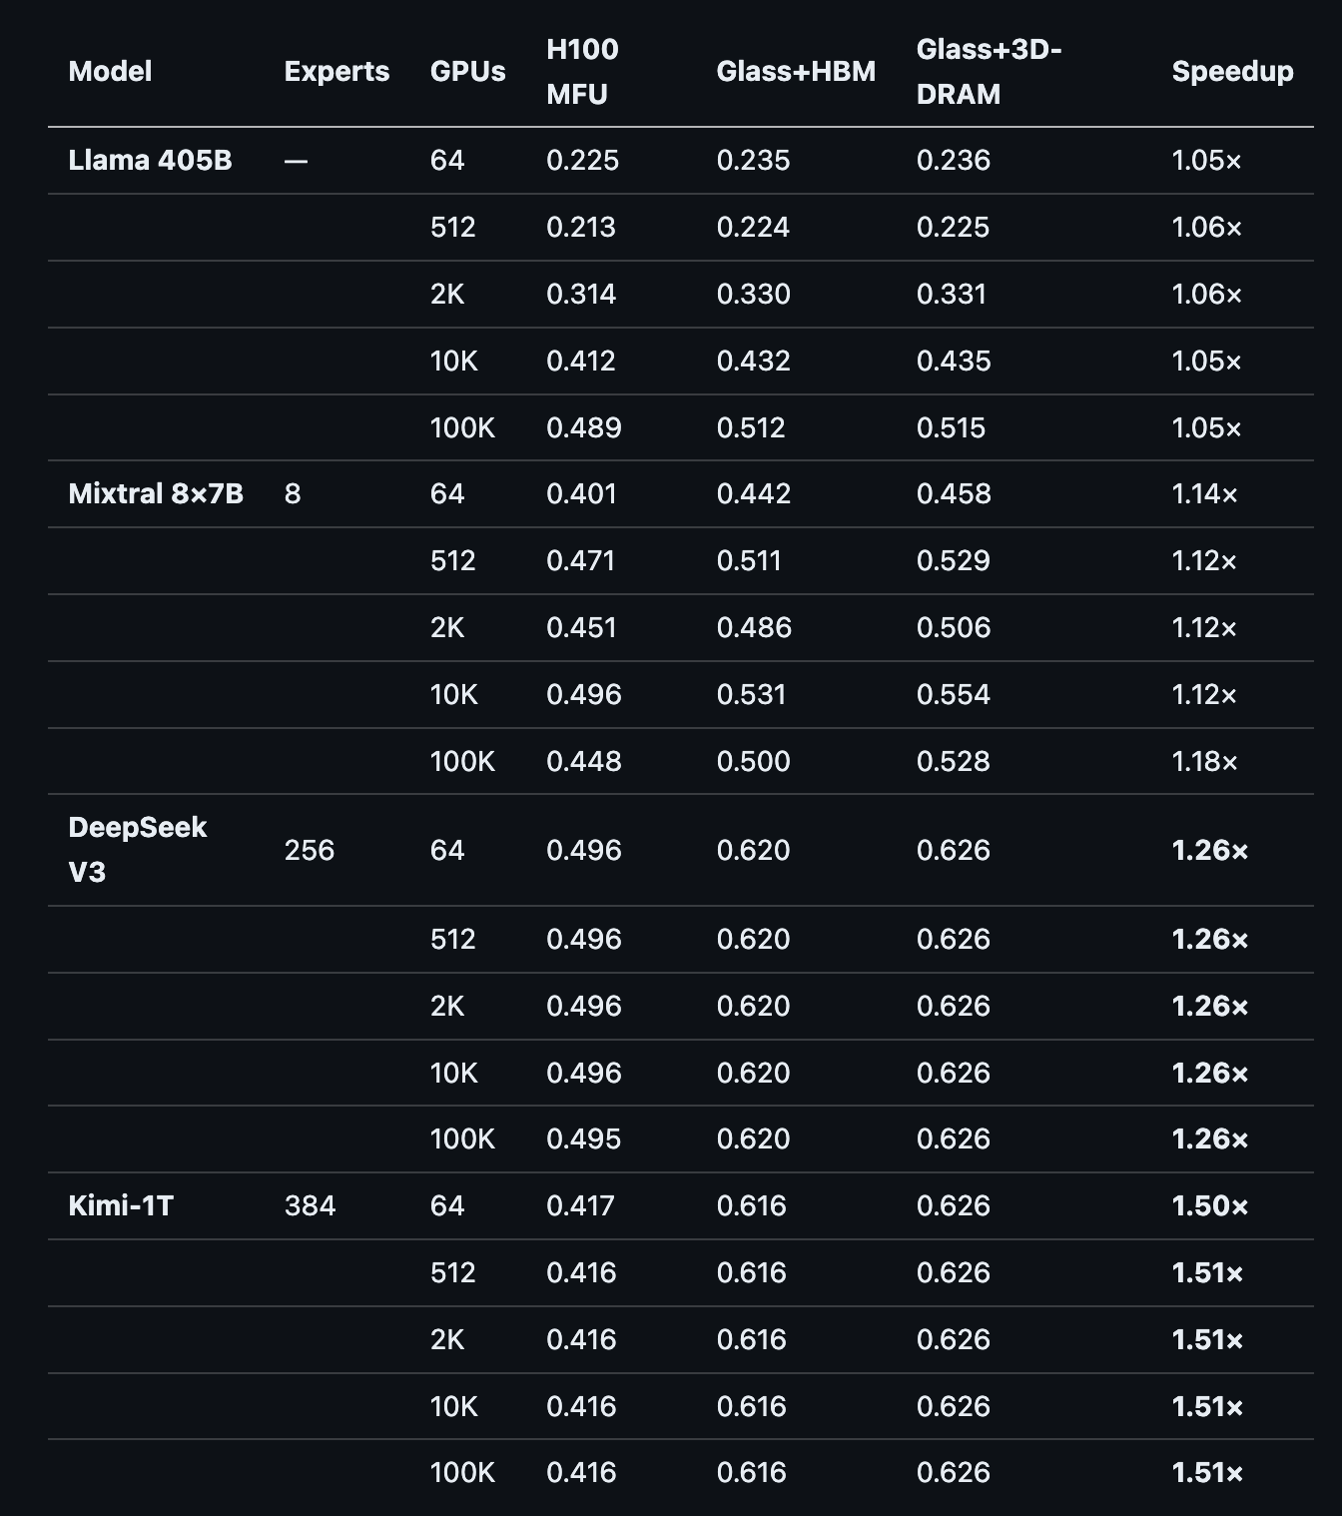
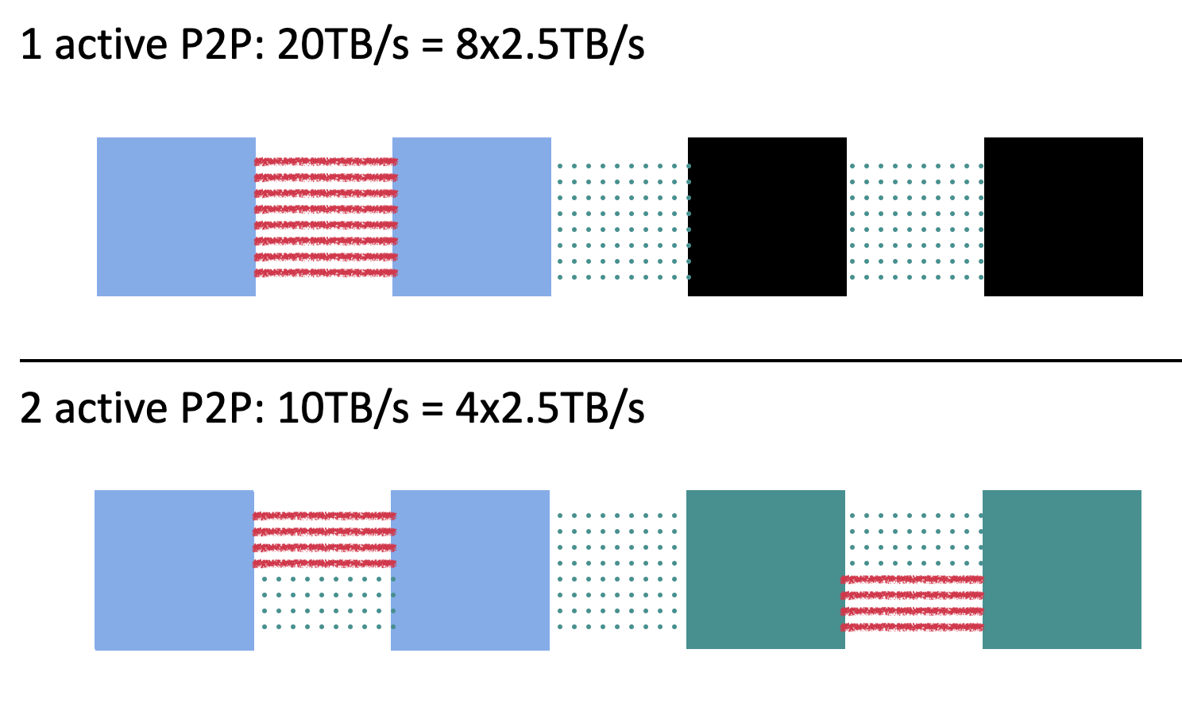
Notes:
think about when “compute imbalance” is actually a good strategy. – so that we can balance that with the network time…
Optical simulator

Slide 28
Mingjia
LLM | Training | Inference
Small scale (a few nodes) | Compute bound | Memory bound
Large scale | MFU 40-50%
Glass interposer proposal
  Literature survey on LLM / Video-gen model training/inference
  Memory Capacity solutions: gradient checkpointing, cpu offloading, TP/PP/SP/CP parallelism (power).
Worldmodel Finetune
  We have done with Minecraft and start to train on NVIDIA Nitrogen dataset
    Use inpainting to remove the noisy overlay of game play scenes, and get 200k 3s clips
    Finetune the video gen model but didn’t easily learn action condition as MC, potentially due to noisy action labels
  TODO: Finetune 720p LTX-2 to be 1080p
Video gen | Training | Inference
Small scale (a few nodes) | Compute/Memory Capacity bound | Mostly compute bound given large Query size
Large scale (hundreds of nodes) | MFU 30-40%

Slide 29
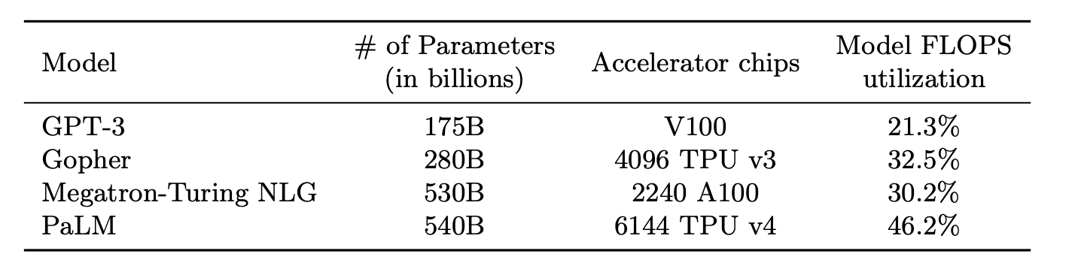

Slide 30
Junda
Glass substrate (w/ David + Mingjia) → Micro April? [260B$]
Mostly more time deep dive into glass substrate + (more-accurate) simulation using AstraSim
  Waiting for David <> Professor Li’s number: the network bandwidth can be huge
Story 1: Latency-sensitive inference & memory capacity-bound workloads in LLM
  Network Bandwidth (across-switch): 160Tbps → 20TB/s = 10x Rubin
  Network Latency: 10-50 ns optical hop vs 1-5μs NVLink
Story 2: Training for large-scale (100k) GPU of LLM (compute / memory / network)
  Environment: H100 GPU DGX, intra-node NVLink (900GB/s), cross-node Infiniband (100GB/s)
  Limitation: limited parallelism strategy search, back-of-the-envelope
    Kimi2.5 MoE 256k 64 GPU: 95% / 2% / 3%
    Kimi2.5 MoE 256k 1024 GPU: 75% / 10% / 15%
    Kimi2.5 MoE 256k 100k GPU (xAI): 60~65% / 15% / 20~25%
Next step: Need to learn more about hardware limitation for a system problem
  More first-order analysis
    Training: 64 ~ 100K+ xPU, a better simulated analysis – with different parallelism setup
    Hybrid storage with energy efficiency considerations
    Design custom MoE all-to-all protocol exploiting optical multicast → near-zero communication overhead
  Build accurate simulator (AstraSim)
Simulated numbers
Network latency: 1.3–6.4μs (glass) vs 128–640μs (NVLink) → ~100× reduction for All-to-all
Network bandwidth: ~160Tbps so far across substrate
Notes:
Refs
Intro-glass-1, intro-glass-2, intro-glass-3

Slide 31
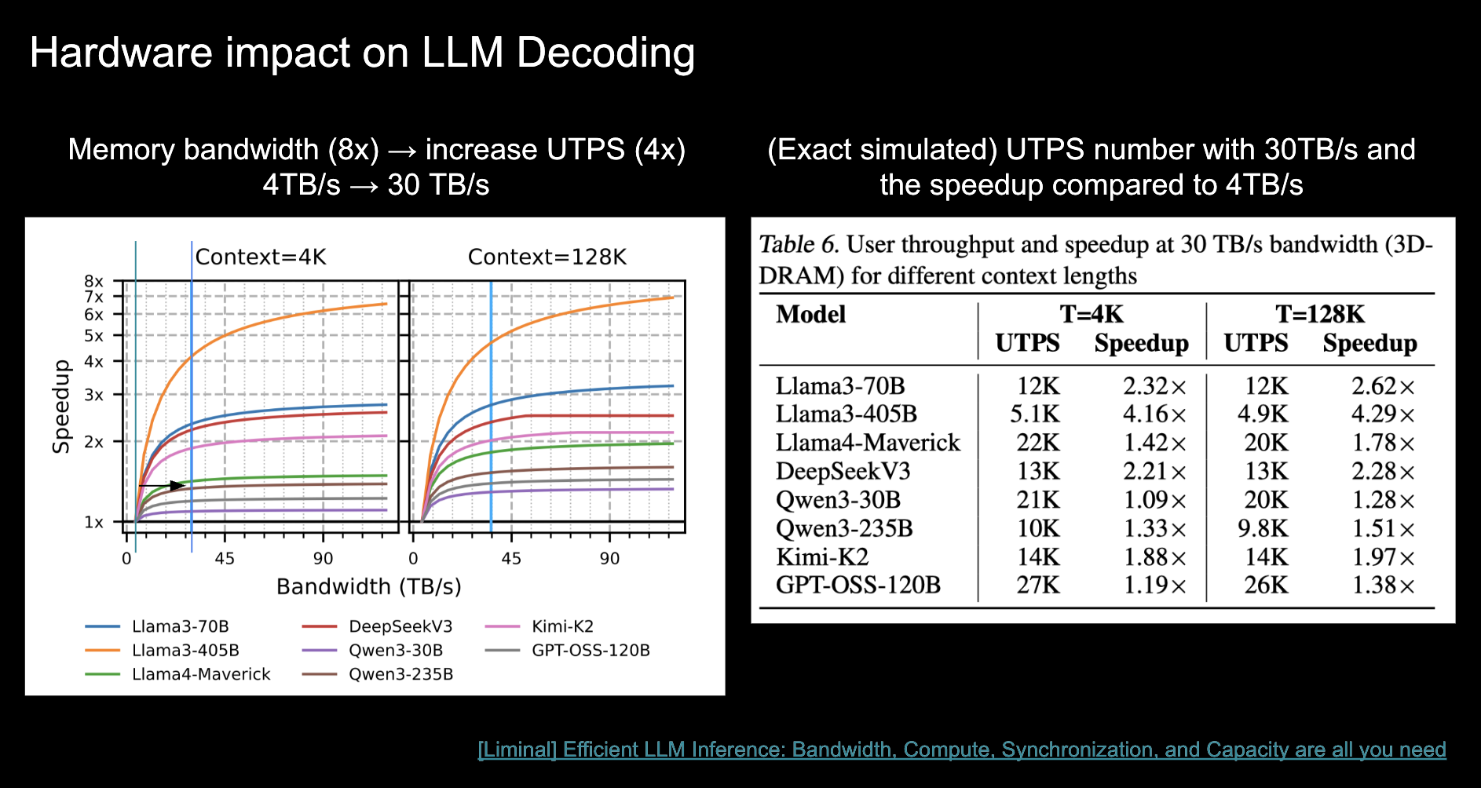

Slide 32
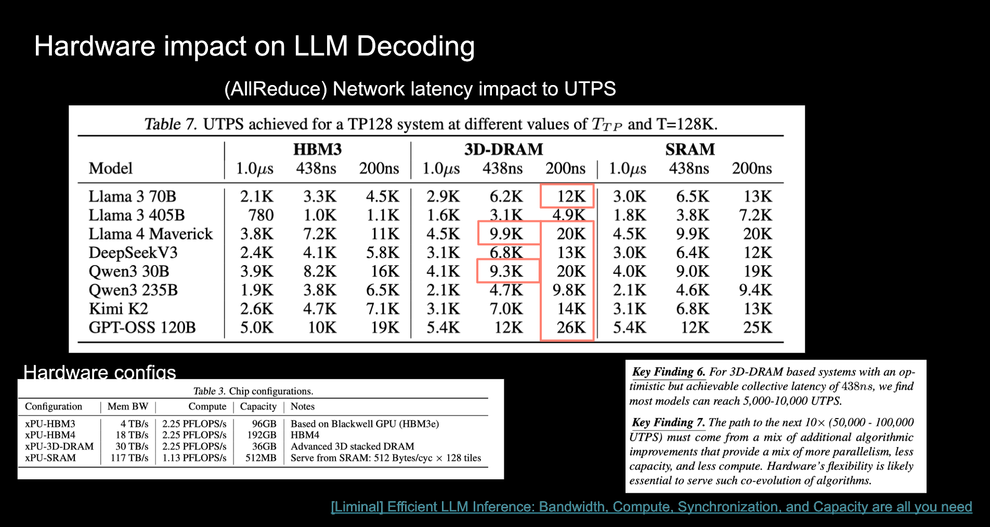

Slide 33
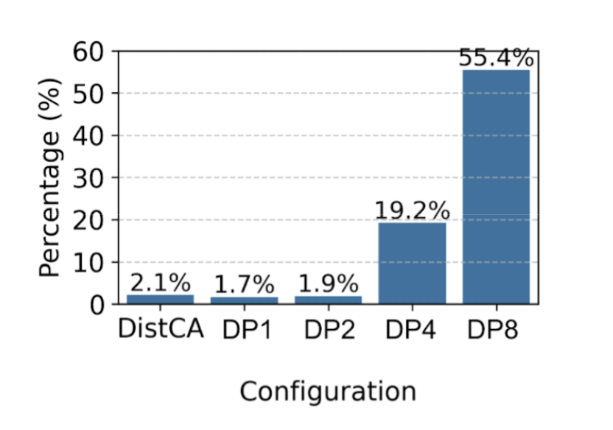
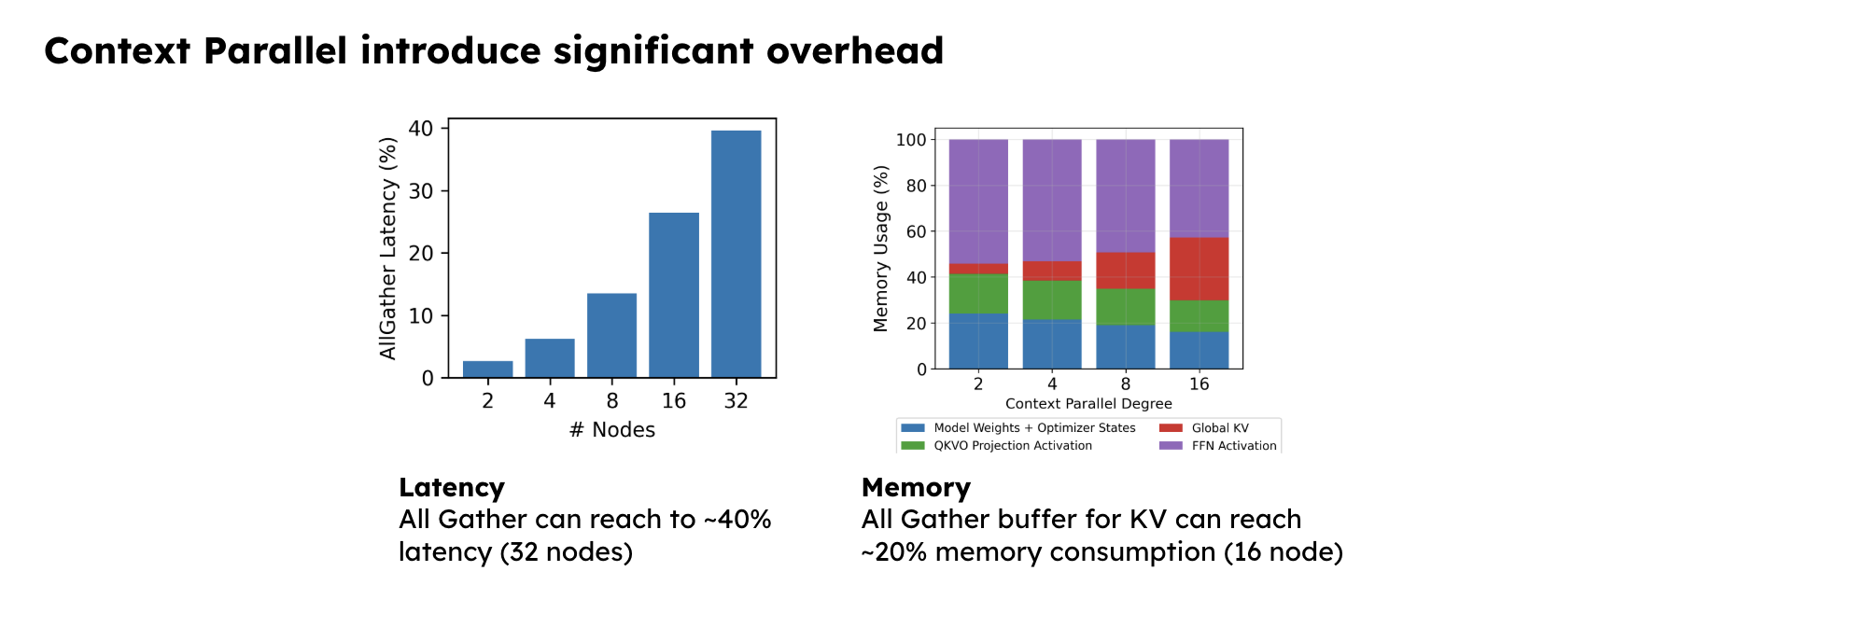

Slide 34
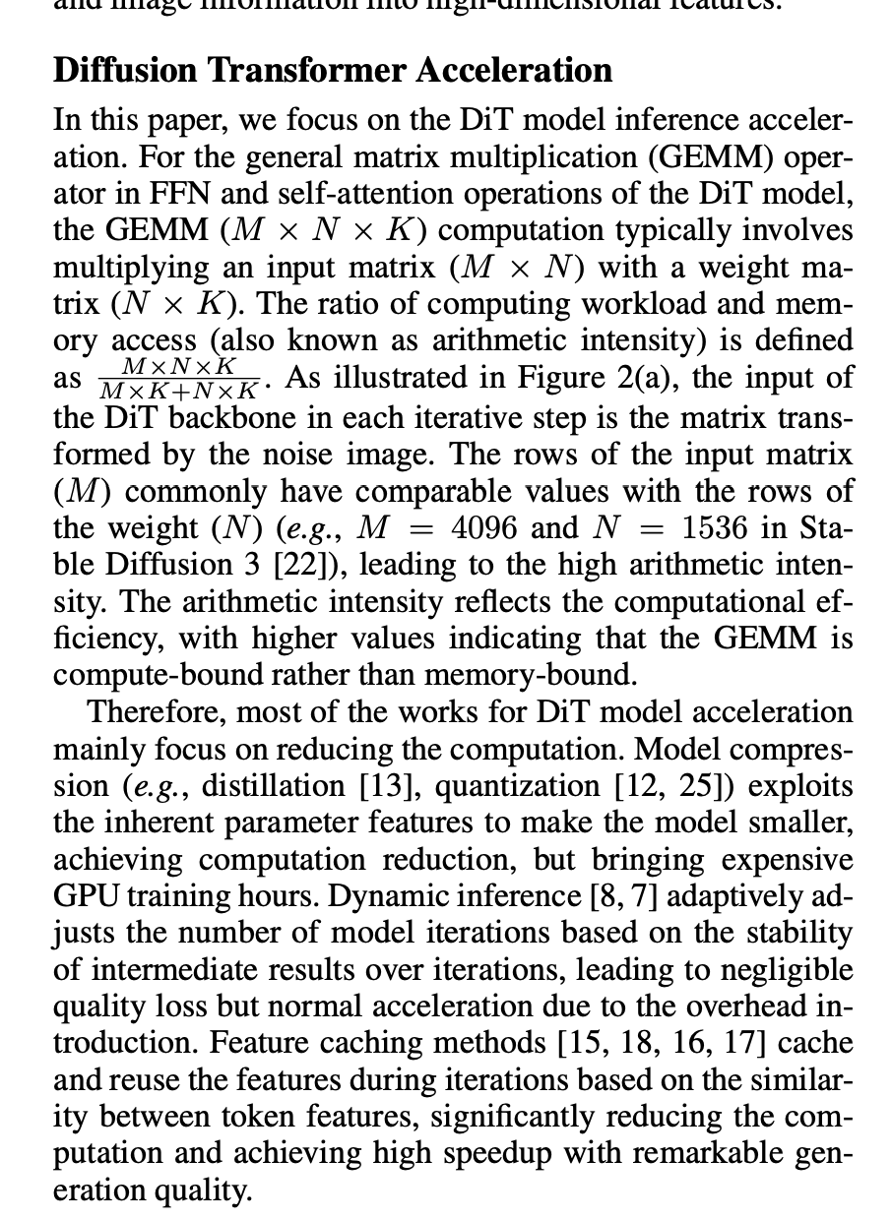
Mingjia
Related work: SpecDiff: Accelerating Diffusion Model Inference with Self-Speculation https://arxiv.org/pdf/2509.13848v1
Compute arithmetic intensity of attn operation in video gen
  FLOPS:
    QK^T: Batch × Head × (Q_len × KV_len × 2 × Dim)
    attn × V: Batch × Head × (Q_len × KV_len × 2 × Dim)
  Bytes Transferred:
    Bytes read: Batch × Head × (Q_len + 2 * KV_len) × Dim
    Bytes written: Batch × Head × Q_len × Dim
  AI ~ len of Q; Current Q_len of a chunk of 0.6s = 6k
  Ridge point of current GPUs: AI ~ 0.2 - 1.2k
  Low-latency high fps generation?
Long-video:
  Still attention bound.
  Using torch profiling, I can only check the CPU <=> GPU memory time, so need to run ncu to profile GPU cache, and report the statistic.
Worldmodel Finetune
  Fine Tuned Wan 1.3B model with action condition on MC data
  We are able to learn the key and mouse conditions with 10k steps with batch_size=32.

Slide 35
Junda
Glass substrate (w/ David + Mingjia) → Micro April? [260B$]
Mostly spend time deep dive into glass substrate and related technologies
Story: Latency-sensitive inference & memory capacity-bound workloads in LLM
  Bandwidth
    Network Bandwidth = 2x Blackwell NVL72, but = ~0.5x Rubin NVL72
    Network Latency: low (10-50ns optical hop vs 1-5μs NVLink)
  Compute
    Per-slot: same B200 die
  P/D disaggregated → can dedicate slots to prefill vs decode (8×8 = 64 slots)
Multicast read becomes relatively cheap ⇒
  MoE all2all network is cheap, barring limited times for reconfiguration for network communication
  Massive memory capacity + hybrid memory ⇒ comp/memory intensive operation specialization
Direction
First order simulation (long-context in=16k/out=4k) (network is an optimistic bound)
  DeepSeek-V3 (MoE, 1.3TB): Glass+HBM3e = 4.95x faster, 9.8x more energy efficient vs NVL72
  Kimi-K2 (~2T MoE, 4TB): Glass+HBM3e = 14.9x faster, 33x more efficient vs NVL72
  Glass+3DDRAM: 2.2x ~ 7.6x faster than NVL72 (less compute slots but huge BW + capacity)
  Dense models (Llama-3 70B): NVL72 still wins - glass substrate shines on large sparse MoE
Next step: Need to learn more about hardware limitation for a system problem
  Better simulation with actual network latency: what is the optimal config <> network protocol
  Drafting short questions about optics
    latency across substrate

Slide 36
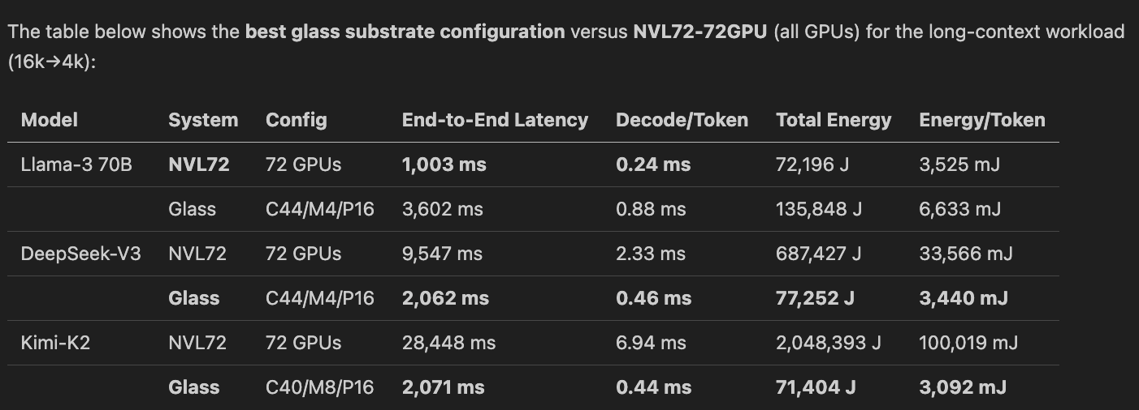
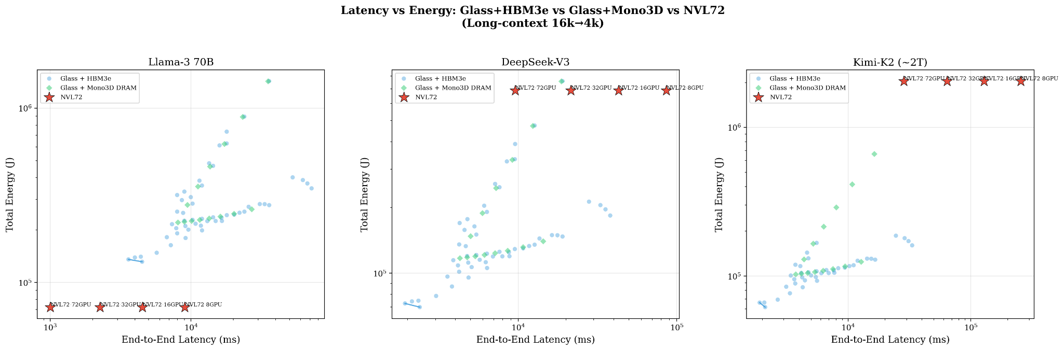
Junda

Slide 37
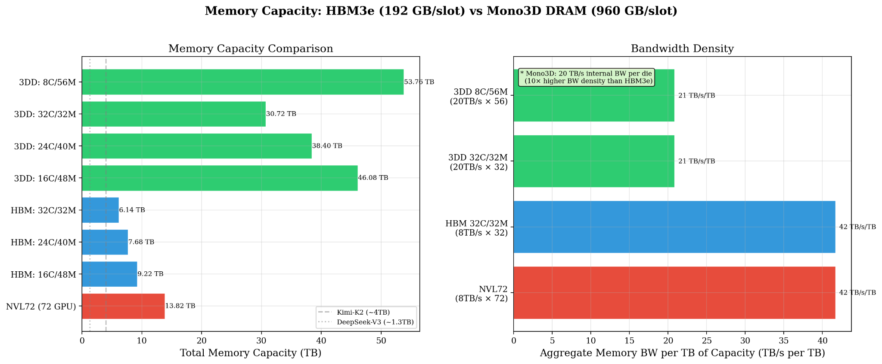
Junda

Slide 38
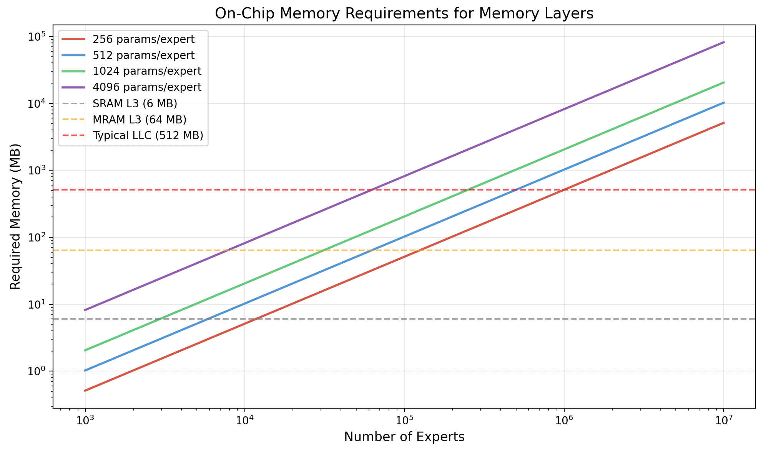
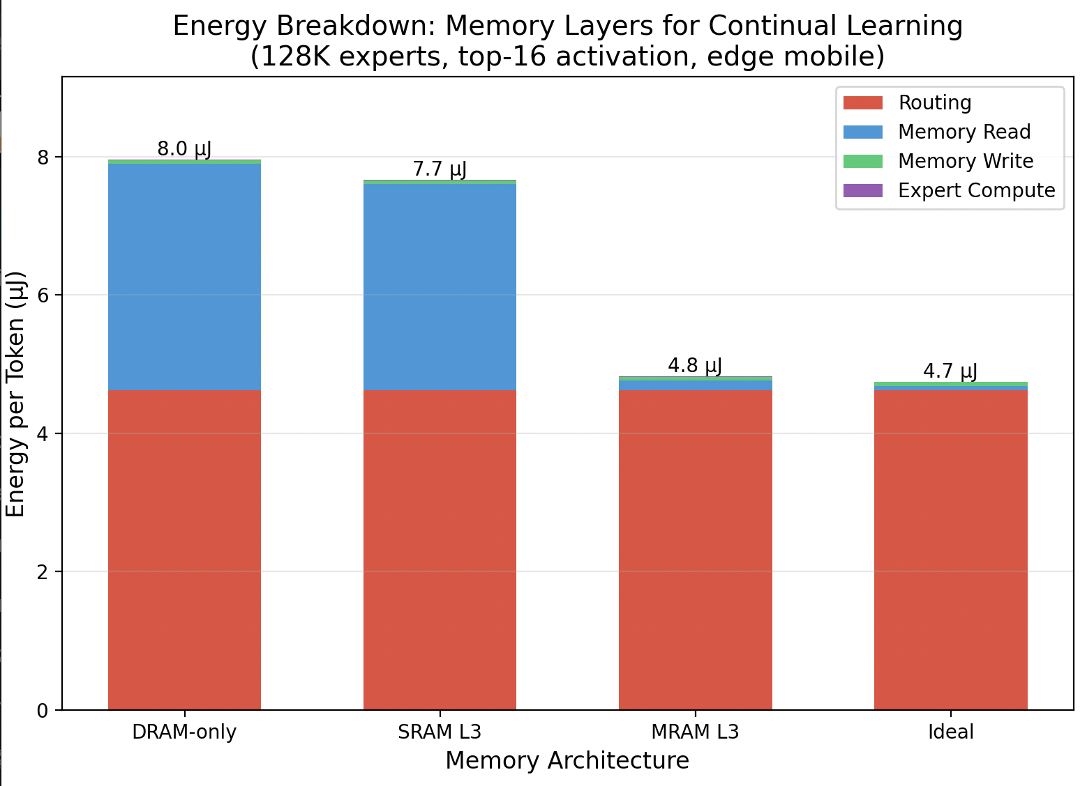
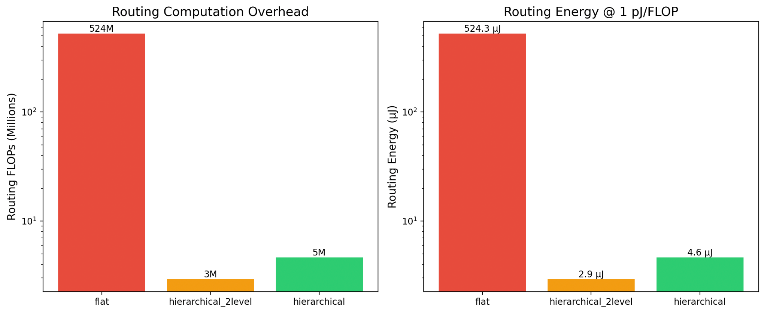
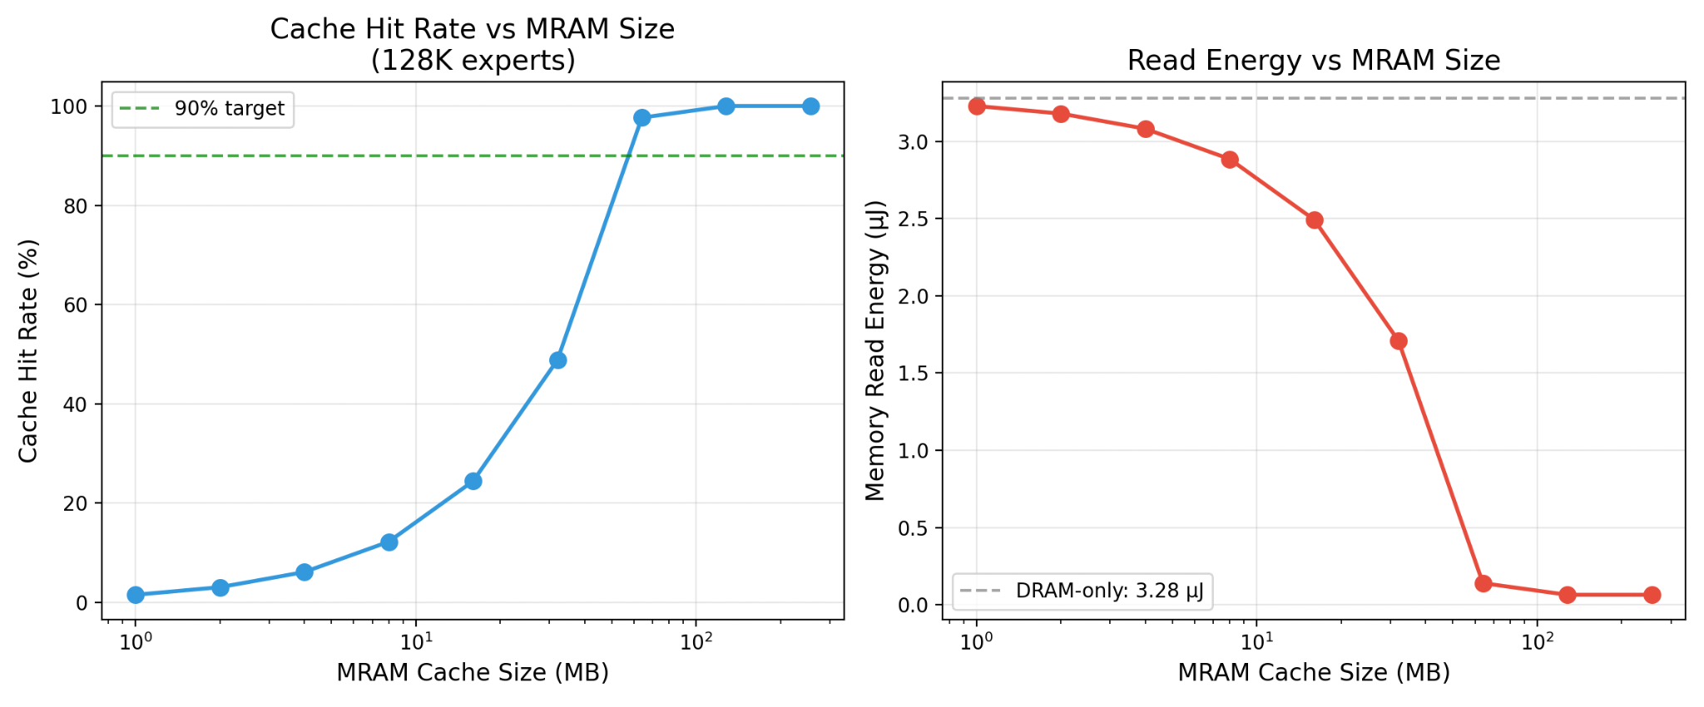
Junda
DistCA: MLSys’26 accepted! 🎉🎉
Associative memory w/ LLM Agent → ISLPED March?
  Background: Associative memory model
    → Mixture of Million MoE: very very sparse MoE to support fine-grain fine tuning
    → Meta Memory Layer: Turn MLP → KV-like memory layer
    Google Titan, Miras, Deepseek Engram: long-term memory layer (related work, but not focus)
  Story:
    (memory capacity) Fine-tuning memory layer require massive memory to store
    (memory bandwidth / energy) Prefetch KV / MoE experts
  Prelim result (back-of-the-envelope): see figures
  Next Step:
    Build a better simulator first-order analysis
    Reproduce sparse memory layer benchmark → maybe a quick win?
Glass substrate (w/ David + Mingjia) → Micro April? [260B$]
  Advantages:
    Multicast read becomes very cheap ⇒
      MoE all2all network will be super cheap
      Can design algorithm to achieve perfect compute & memory balance
    Massive memory capacity + hybrid memory ⇒ comp/memory intensive operation specialization
  Next step: Need to learn more about hardware limitation for a system problem
    Design different network protocol (all2all) → massive MoE acceleration

Slide 39
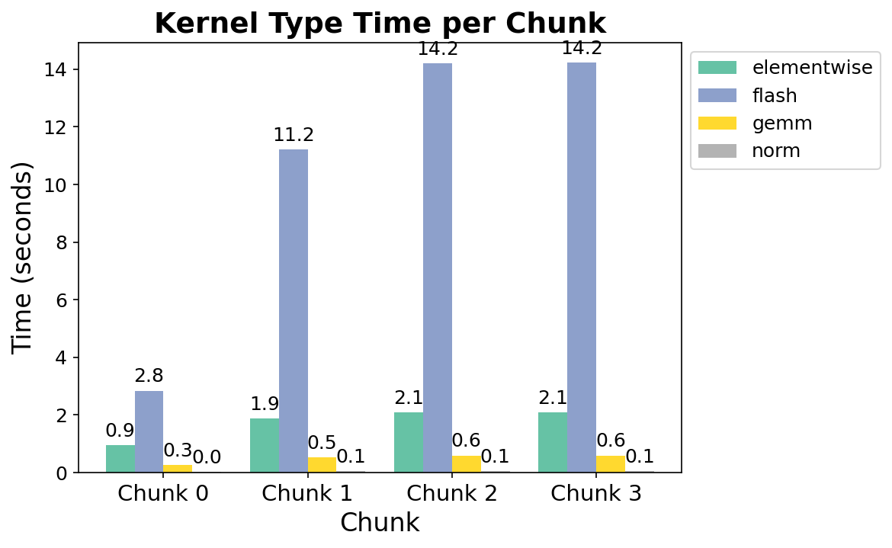
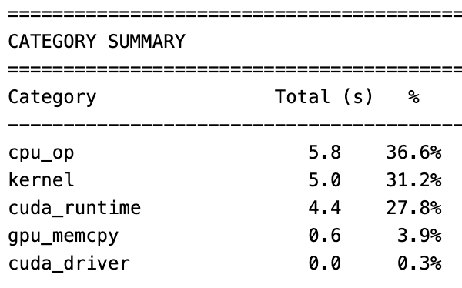
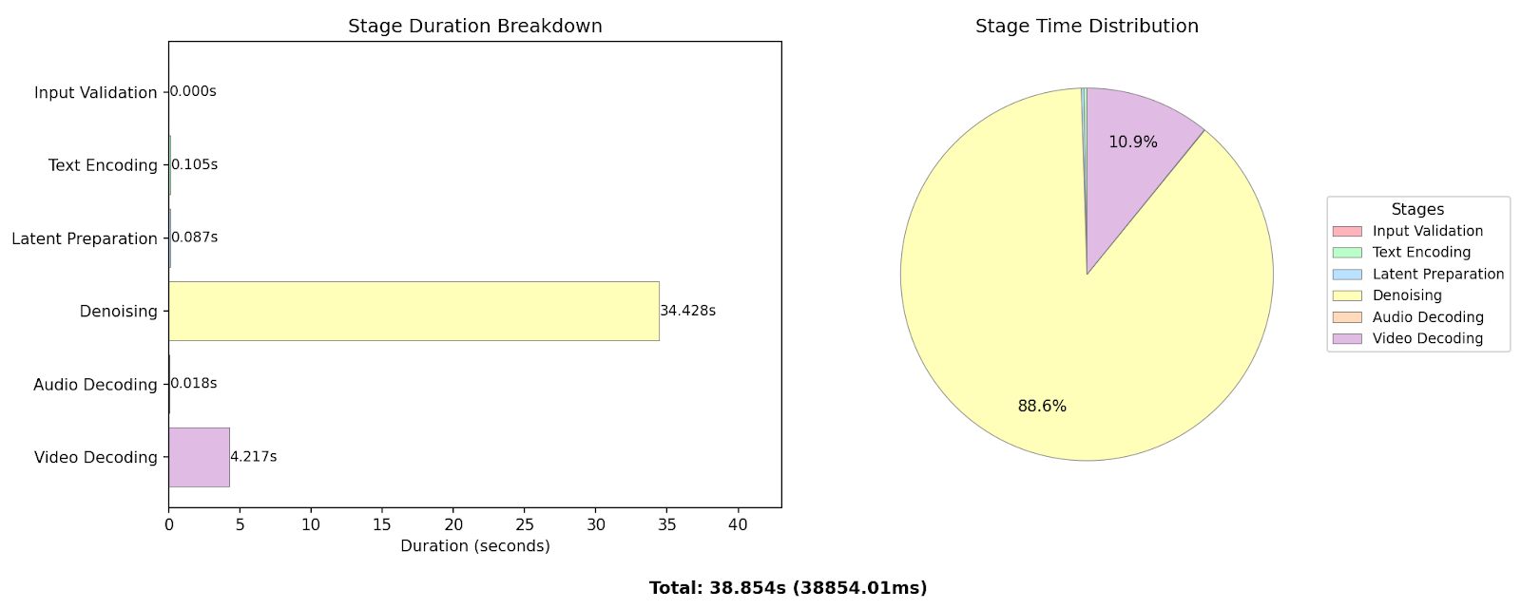
Mingjia
Profiling World Model
  HYWorld-8B Teacher Model: Generating Chunk by Chunk, with one chunk = 2.5 seconds.
  Multi chunk generation: video length = 10 seconds (4 chunks in total)
    Their caching strategy make sure the history chunk at most 2.
    So chunks 2 and chunk 3 have similar generation time.
  GPU: 1 H200
  Conclusion:
    Highly Compute Bound
    attention dominate since it requires another cross attn to add action condition for each transformer block

